Slide 1
Extracting (good) discourse examples from an oral specialised corpus of wine tasting interactions
Patrick Leroyer¹, Arnaud Millereux², Hedi Maazaoui³, Laurent Gautier⁴
¹ Aarhus University, Jens Chr. Skous Vej 4, DK-8000 Aarhus
² Université de Bourgogne, 6 esplanade Erasme, BP 26 611, F-21066 Dijon Cedex
³ Université de Bourgogne, 6 esplanade Erasme, BP 26 611, F-21066 Dijon Cedex
⁴ Université de Bourgogne, 6 esplanade Erasme, BP 26 611, F-21066 Dijon Cedex

Slide 2
The Oenolex dictionary of wine-tasting
Commissioned by the wine-industry of Burgundy
  For experts (teaching wine-tasting) and non-experts (learning wine-tasting)
  Industrial information tool: What do they say about our wines? What do we say?
  Corpus of oral interactions: wine-tasting courses, fairs, wineries
    In-house entries and expertise labelling (expert/non-expert)
    Definitions and collocations
    Examples/audio files
    Links
    Work in progress

Slide 3
Data recording and processing
TASCAM DR-07 MKI digital recorder.
Data format = French standards for Digital Humanities (Huma-Num 2015).
Uncompressed 24-bit/96 kHz WAV; AUDACITY software for deleting irrelevant data
Preservation of spontaneous discourse (no noise reduction, clipping or signal amplification); orthographic transcription with annotation of turn takings, overlaps, pauses, non-verbal productions, etc.
Data processing with SONAL®: transcription formatting, synchronisation of transcription and speech-data, annotation and tagging of segments
Double tagging: themes (‘process’, ‘action’, ‘definition’, …) and discourse markers

Slide 4
Discourse markers – phases, directives, negatives
On va continuer la dégustation par un Bourgogne Aligoté 2012….;
Au premier nez, on est sur des fruits plus mûrs, on n’est pas sur le côté citronné, agrume, mais sur le côté prune.
le vin a vieilli, mais il a vieilli combien ? C’est ça la question, chauffez-le bien dans vos mains.
On n’est pas sur le côté citron, agrume, mais sur le côté prune.
EneL Herstmonceux, WG3, 13 August 2015 – Leroyer, Millereux, Maazaoui, Gautier

Slide 5
Data management system
  Language: Java v8, XML and XSL(T)
  IDE: NetBeans v8.0.2
  Frameworks : Java Server Faces v2.2, Prime Faces v5.x
  Linux Debian 7 (Wheezy) 64 bits
  Apache Tomcat 8.x
  RDBMS : MySQL 5.x

Slide 6


Workflows
Event
Interview
Audio recording
Transcription
Audio warp and annotation
Tagging
Data automation
Converters
Publish and browse

Slide 7
Data acquisition, access and display
  Data provided by Sonal 1.9.3 and exported to convenient format
  Correction of output files for syntax errors. Errors are localized during content analysis and simplify next automation treatments
  Conversion to flat standard XML, and XML/TEI open format
  Access to audio data through linking of associated lemmas in transcription corpus and dictionary
  Interactively retrieved by search engine (buttons and links)
  Dynamically added to web pages

Slide 8
Search engine and nodes
  Data storage according to predefined lexicographic scheme by project team and computing managers
  Development of semantic web techniques
  Nodes: transcription sequences – lemmas – audio segments
  Connections using XML and automatically built-in annotations during data import with dictionary data help

Slide 9
In short
Corpus at heart of dictionary = fully fledged functional component
Discourse examples = knowledge of discourse = central data category
Lemmas are access nodes

Slide 10
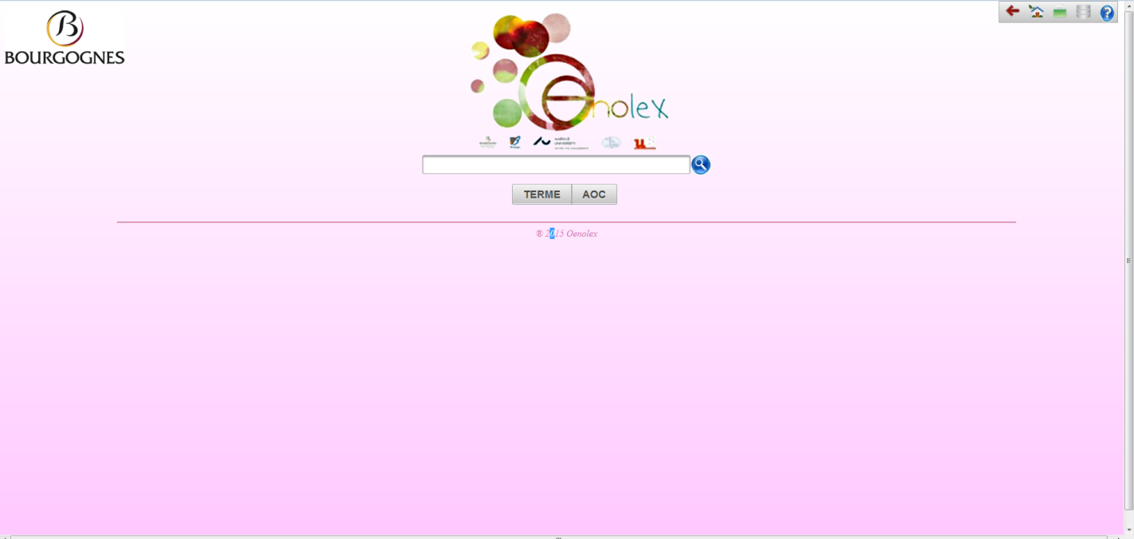
2 search modes
Term = citron
AOC = bourgogne

Slide 11

Thank you for your attention
pl@asb.dk
Arnaud.Millereux@u-bourgogne.fr
Laurent.gautier@u-bourgogne.fr
Hedi.Maazaoui@u-bourgogne.fr

Slide 12
Literature
Books:
Gunnarsson, B. L. (2009). Professional Discourse. London: Continuum.
Book sections:
Gautier, L. & Leroyer, P. (2015). Construction, communication, représentation et réappropriation des discours vitivinicoles dans un ‘nuancier’ lexicographique en ligne. In C. Condei et al. (eds). Situations professionnelles, discours et interactions en traduction spécialisée. Berlin: Frank und Timme, in press.
Meyer, I. (2001). Extracting knowledge-rich contexts for terminography. In D. Bourigault et al. (eds.) Recent Advances in Computational Terminology. Amsterdam/Philadelphia: Benjamins, pp. 279–302.
Paper in conference proceedings:
Leroyer, P. & Valentina, H. & Maazaoui, H. & Chevalier, F. & Gautier, L. (2015). Faire déguster et parler de son vin pour le faire aimer et le vendre : quelques stratégies dans des interactions producteur-client. Actes de International Wine Symposium of Toulouse, Université Toulouse – Jean Jaurès.
Websites:
Audacity. Accessed at: http://www.audacity.fr (25 May 2015)
Guide méthodologiques pour le choix de formats numériques pérennes dans un contexte de données orales et visuelles. Accessed at http://www.huma-num.fr/ressources/guides (25 May 2015)
Guide des bonnes pratiques du numérique. Accessed at http://www.huma.num.fr/ressources/guides (25 May 2015)
Michelfeit, J. GDEX in Sketch Engine. ENeL 12 February 2015, WG3, Vienna, Accessed at : http://www.elexicography.eu/working-groups/working-group-3/wg3-workshops/automatic-extraction-of-good-dictionary-examples/ (25 May 2015)
Sonal®. Accessed at http://www.sonal-info.com (25 May 2015)
Journal articles:
Gautier, L. & Hohota, V. (2014). Construire et exploiter un corpus oral de situations de dégustation : l’exemple d’OenoLexBourgogne. Studia Universitatis Babes-Bloyai, Philologia 59/4, pp.157-173.
Leroyer. P. (2013). Proposals for the Design of Integrated Online Wine Industry Dictionaries. Lexikos 23, pp. 1-18.
Teubert, W. (1996). Comparable or Parallel Corpora? IJL 9/3, pp.238-264.
Dictionaries:
Bottlenotes. Wine glossary and encyclopedia. Accessed at : http://www.bottlenotes.com/winecyclopedia/glossary (13 May 2015)
Coutier, M. (2011). Dictionnaire de la langue du vin. Paris: CNRS Editions.

