Slide 1
Neologisms
Experiences from EURAC & INL
Egon Stemle, Miloš Jakubíček & Carole Tiberius

Slide 2
Outline
Workflow INL & EURAC
Sketch Engine & Neologisms

Slide 3
Workflow EURAC
Similar to INL workflow (but of course with different data)

Slide 4

Workflow INL
XML-Newspaper A
Jenkins scheduler
Periodically checking for new XML files
Convert XML from raw to well-formed
XML-Newspaper B
Convert to TEI
Internet
INL-FTP Server
Neologism extraction Perl script
Input to Corpus Contemporary Dutch
chn.inl.nl
Etc. etc.
Neoloog editing environment

Slide 5
The INL-Perl neoloog script
Exclusion lists
  Dutch Spelling Database
  Corpus Hedendaags Nederlands (up to 2015)
Filters (specific cases)
  Bigrams/trigrams
  Words with more than one capital
  Diacritics
  Non-words
  Stemming (e.g. groene > groen)

Slide 6
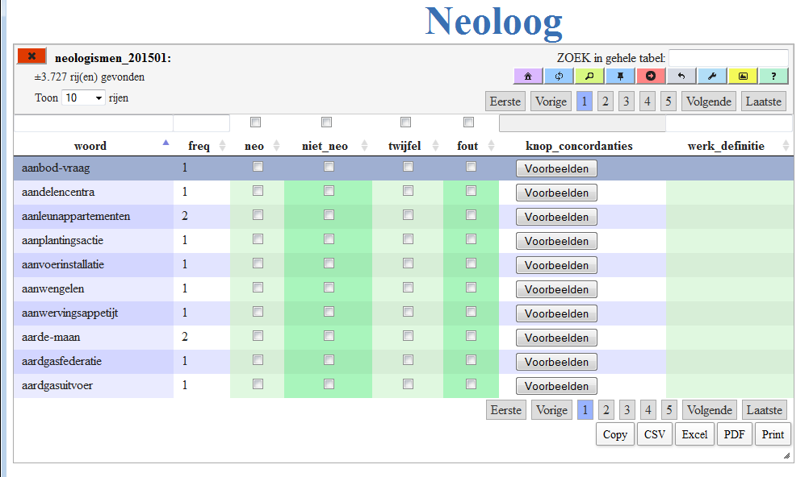
The INL editing environment

Slide 7
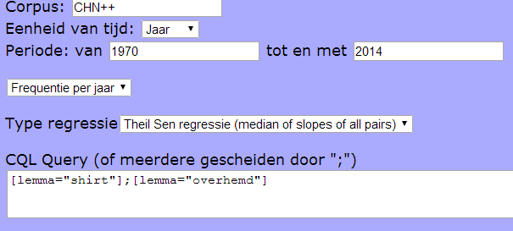
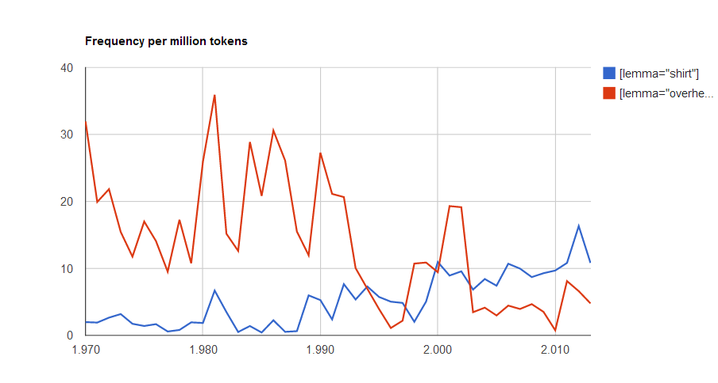
INL Future plans
Molechaser (Monitoring Lexical Change) in BlackLab:
shirt
overhemd
https://github.com/INL/BlackLab

Slide 8
Sketch Engine & Neologisms
DIACRAN
https://elex.link/elex2015/videos/
Adam Kilgarriff, Ondřej Herman, Jan Bušta, Vojtěch Kovář and Miloš Jakubíček: DIACRAN: framework for Diachronic analysis

Slide 9
Web scraping (also: web data extraction) is a computer software technique of extracting information from websites. Usually, such software programs simulate human exploration of the World Wide Web...
Egon Stemle (EURAC)
Notes:
Egon Stemle mentions a possible technique to harvest web data together with more reliable metadata.

Slide 10
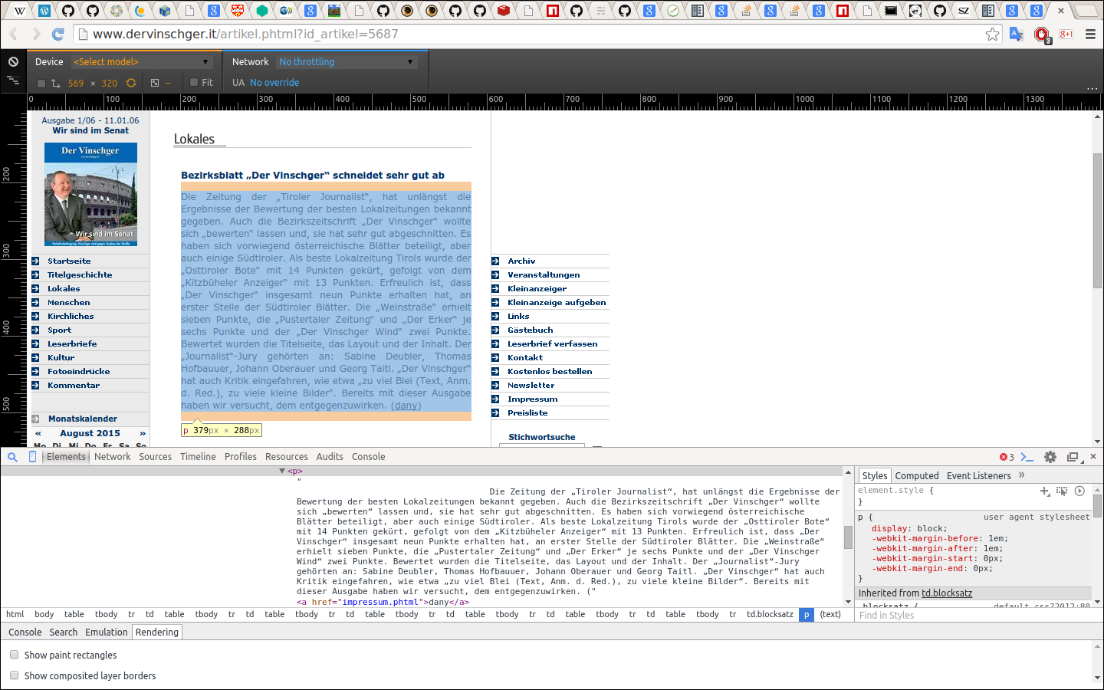
Egon Stemle (EURAC)

Slide 11
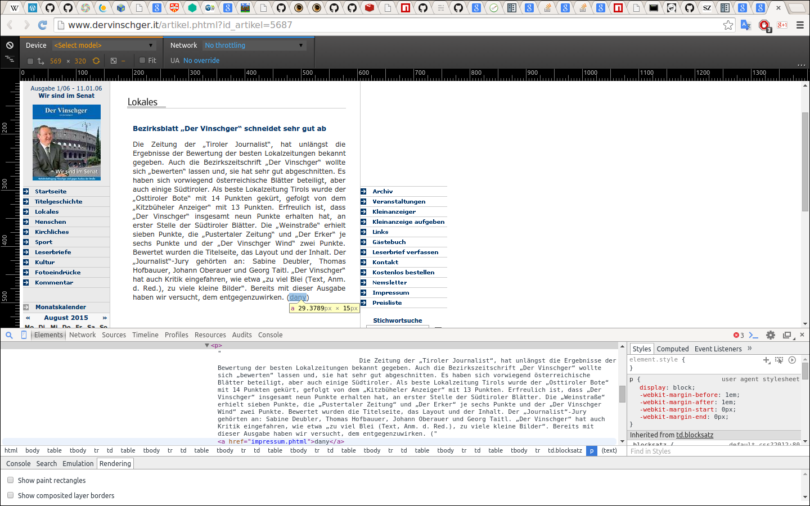
Egon Stemle (EURAC)

Slide 12
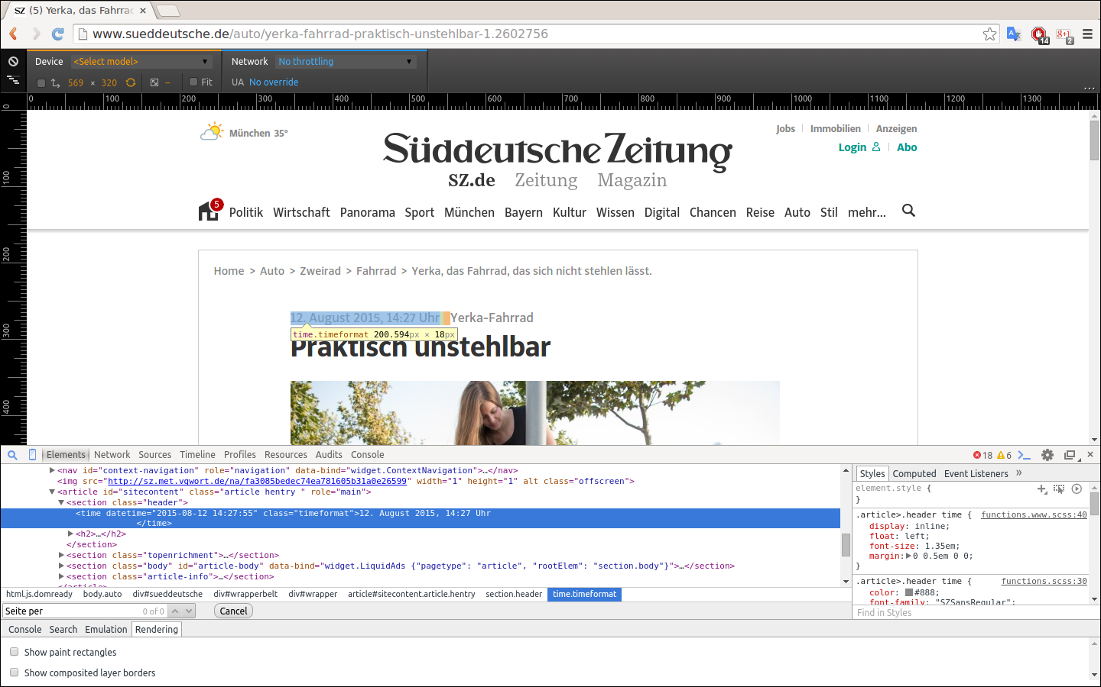
Egon Stemle (EURAC)

Slide 13
Web scraping (also: web data extraction) is a computer software technique of extracting information from websites. Usually, such software programs simulate human exploration of the World Wide Web...but we can also use Web scraping to extract structured information from (predefined) Web pages.
<article>
<author>dany</author>
<date>2015-08-12</date>
<time>14:27</time>
<text>Die Zeitung der "Tiroler Journalist", hat unlängst die ...</text>
</article>
Egon Stemle (EURAC)

