Slide 1
Visualisation of Word Senses on the Concordance Level ENeL WG3 @Herstmonceux
Kris Heylen
Quantitative Lexicology and Variational Linguistics

Slide 2
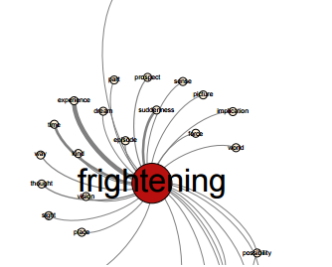
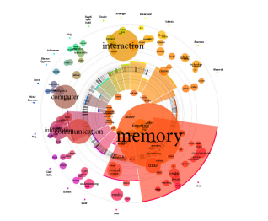
Visualising Senses: Collocates vs Concordances
Visualisation of senses through usage patterns on two levels:
Collocations (in wordsketches):
Similar collocates are grouped together and showed as close together or connected
Hask Collosaurus SketchEngine
Notes:
For more information on visualization of sense information in the SketchEngine see: http://is.muni.cz/th/374080/fi_m/thesis.pdf

Slide 3
Visualising Senses: Collocates vs Concordances
Visualisation of senses through usage patterns on two levels:
Collocations (in wordsketches):
Similar collocates are grouped together and showed as close together or connected
Hask Collosaurus, Sketchengine,
Concordances (occurrences, citations)
Group concordances together that illustrate the same meaning and plot those as close together in a graph
Interactive scatter plots with concordances as dots
=> complementary perspectives

Slide 4
Similarity of Concordances
Concordances of bank:
Local banks offer loans at better rates
Follow the north bank up stream.
Private sector banks had much lower debts.
Oak forests ran along the river banks .
Obviously (1,3) and (2,4) should be grouped together, but they do not share direct collocates
However, the salient collocates of the collocates do show overlap!

Slide 5
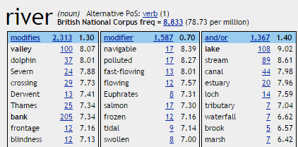
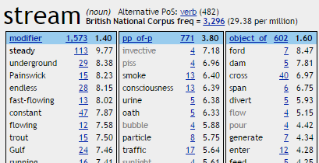
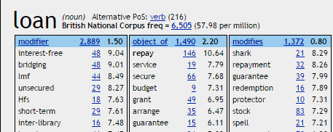
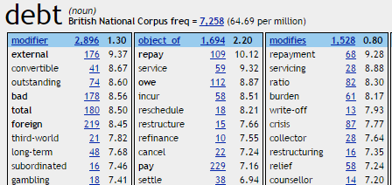
Similarity of Concordances
Concordances of bank:
Local banks offer loans at better rates
Follow the north bank up stream.
Private sector banks had much lower debts.
Oak forests ran along the river banks .
Overlap in signif. collocates of observed collocates:
1 & 2
1 & 3
2 & 3
2 & 4
3 & 4

Slide 6
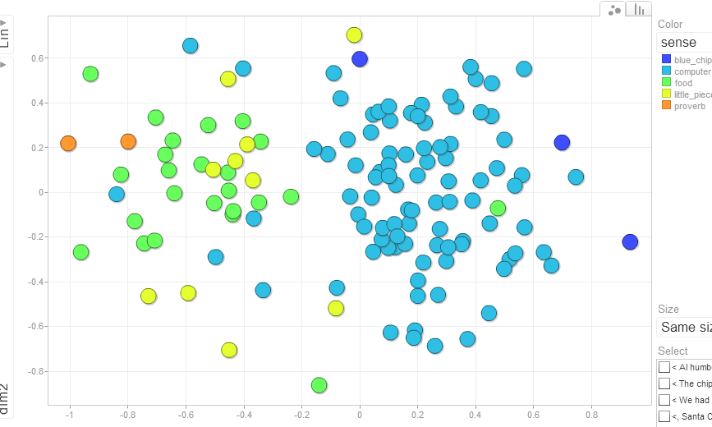
Concordance plot of chip
URL: https://perswww.kuleuven.be/~u0038536/VSVIS/

Slide 7
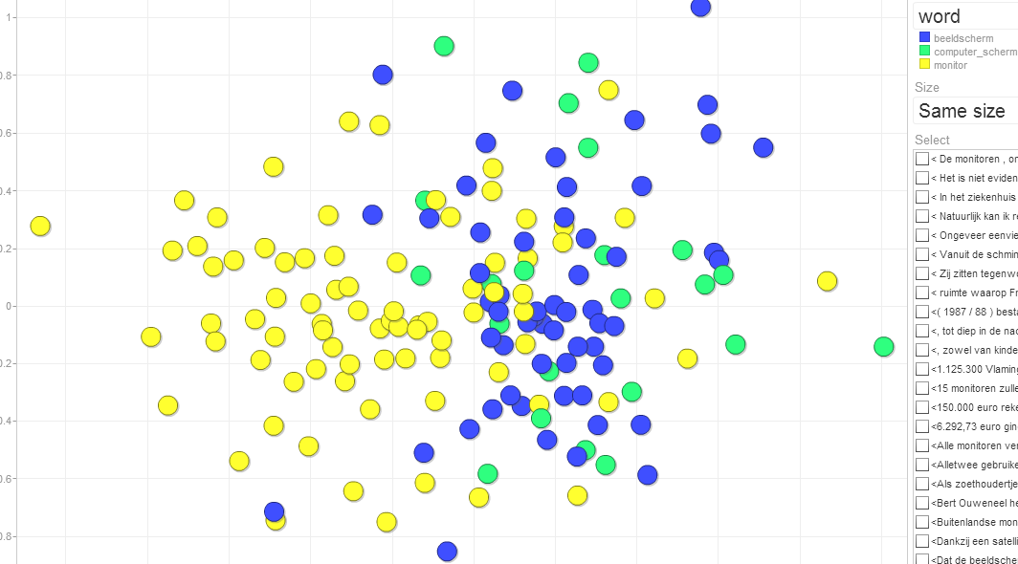
Concordances of monitor together with near synonyms beeldscherm and computerscherm
URL: https://perswww.kuleuven.be/~u0038536/googleVis/wSOCC/beeldscherm.html

Slide 8
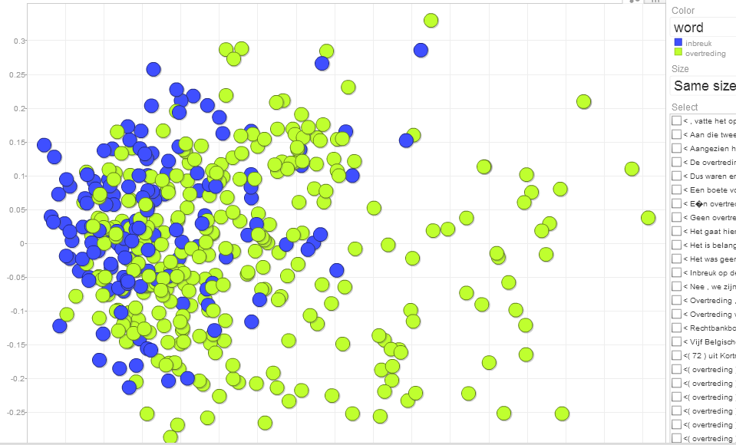
Concordances of inbreuk (infringement) together with near-synonym overtreding
https://perswww.kuleuven.be/~u0038536/googleVis/wSOCC/inbreukOvertreding.html

Slide 9
Conclusions
Visualising proximity of concordances as complementary to visualising proximity of collocates:
Helicopter view of a word’s meaning potential
Direct link to concordances
Contrasting near-synonyms
But:
collocates still are necessary to interpret concordance groupings (switch between two views?)
Only a sample of all concordances can be displayed at the time (integration with GDEX?)

Slide 10
For more information:
http://wwwling.arts.kuleuven.be/qlvl/
kris.heylen@kuleuven.be
Heylen, K., Wielfaert, T., Speelman, D., & Geeraerts, D. (2015). Monitoring Polysemy. Word Space Models as a Tool for Large-Scale Lexical Semantic Analysis. Lingua, 157, 153–172. doi:10.1016/j.lingua.2014.12.001

