Slide 1


Towards a Collaborative Cultural Lexicography Portal: the DARIAH Competence Centre
B. Piringer
R. Barbera, A. Calanducci, C. Carrubba, D. Davidovic, G. Inserra, G. La Rocca,
R. Ricceri and E. Wandl-Vogt
Online Dictionaries, Dictionary Portals and Enhanced Search.
COST ENeL joint WG1/WG4 meeting. Budapest, Hungary.
24. 2. 2017

Slide 2
Towards a Collaborative Cultural Lexicography Portal: the DARIAH Competence Centre
B. Piringer
R. Barbera, A. Calanducci, C. Carrubba, D. Davidovic, G. Inserra, G. La Rocca, R. Ricceri and E. Wandl-Vogt
Online Dictionaries, Dictionary Portals and Enhanced Search.
COST ENeL joint WG1/WG4 meeting. Budapest, Hungary.
24. 2. 2017

Slide 3
Outline
EGI – European Grid Infrastructure
https://www.egi.eu/
DARIAH – Digital Research Infrastructure for Arts and Humanities
http://www.dariah.eu/
  DARIAH – Competence Centre
  https://wiki.egi.eu/wiki/Competence_centre_DARIAH
    DARIAH – Science Gateway
      Semantic Search Engine
      (e-Infrastructure Knowledge Base)
      DBO@Cloud

Slide 4

EGI – European Grid Infrastructure
Federated e-Infrastructure set up to provide advanced computing services for research and innovation
Over 300 data centres and cloud providers in 32 European countries (National grid initiative) and more worldwide
Providing compute power, storage, applications, clouds etc.
EGI-Engage project: Accelerate the implementation of the Open Science Commons by expanding the capabilities of a European backbone of federated services

Slide 5

DARIAH – Digital Research Infrastructure for Arts and Humanities
Pan-European infrastructure for Arts and Humanities
Connecting hundreds of scholars and dozens of research facilities in currently 17 countries
Supporting digital research by providing digital tools, share data and knowhow
Operating the DARIAH Science Gateway, a EGI-service developed within the EGI-Engage project for the Digital Humanities community as target group

Slide 6
DARIAH Competence Centre (1)
The main activities of the centre are:
Making contact between EGI and DARIAH communities to advise DARIAH members in their infrastructural needs
Providing customised e-Infrastructure services for Arts and Humanities – access to EGI FedCloud resources
Creating demonstrator applications for the Arts and Humanities domain to show the capabilities and possibilities with the use of EGI
Raising awareness within the Arts and Humanities scientific community about the benefits of using e-Infrastructure technologies

Slide 7
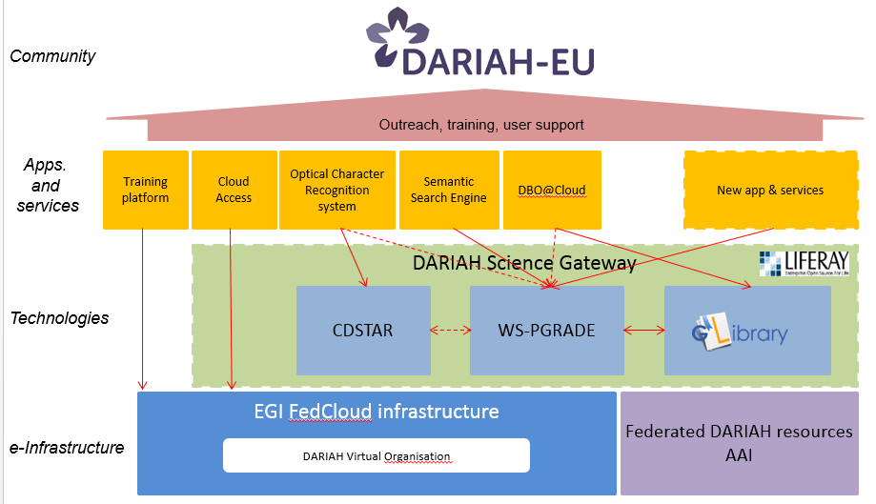
DARIAH Competence Centre (2)

Slide 8
DARIAH Science Gateway
Applications (open access)
  Semantic Search Engine
    Simple Semantic Search Engine (SSE)
    Parallel Semantic Search Engine (PSSE)
  DBO@Cloud
Services (authentication required)
  Cloud Access
  Workflow Development
  File transfer

Slide 9
(Simple) Semantic Search Engine (1)
Developed by the Division of Catania of the National Institute of Nuclear Physics (INFN)
Semantically enriches the metadata of the resources included in the Knowledge Base
Queries in more than 110 languages possible
Results connected to Google Scholar and Altmetric if available
Uses LODLive API to explore the Linked Data graph
Extension: Parallel Semantic Search Engine (PSSE)
https://dariah-gateway.lpds.sztaki.hu/web/guest/psse

Slide 10
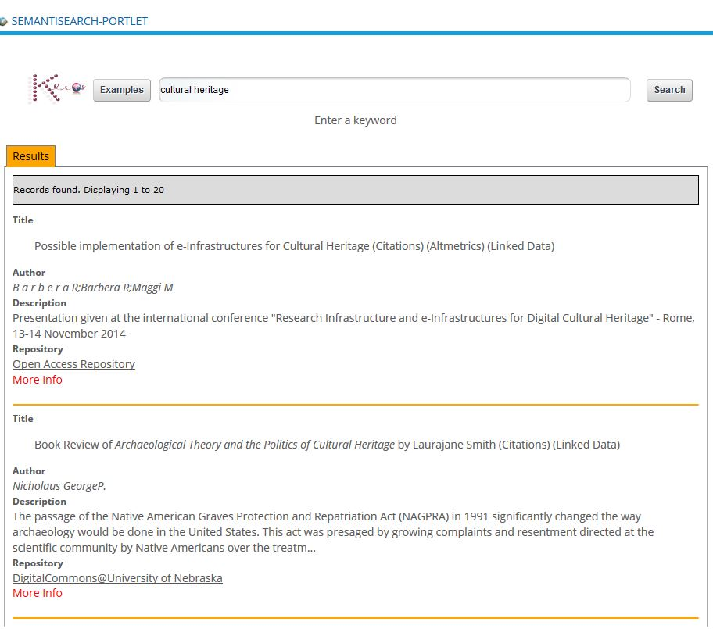


Semantic Search Engine (2)
Explore repositories:
keyword(s) for searching
result list of data entries

Slide 11
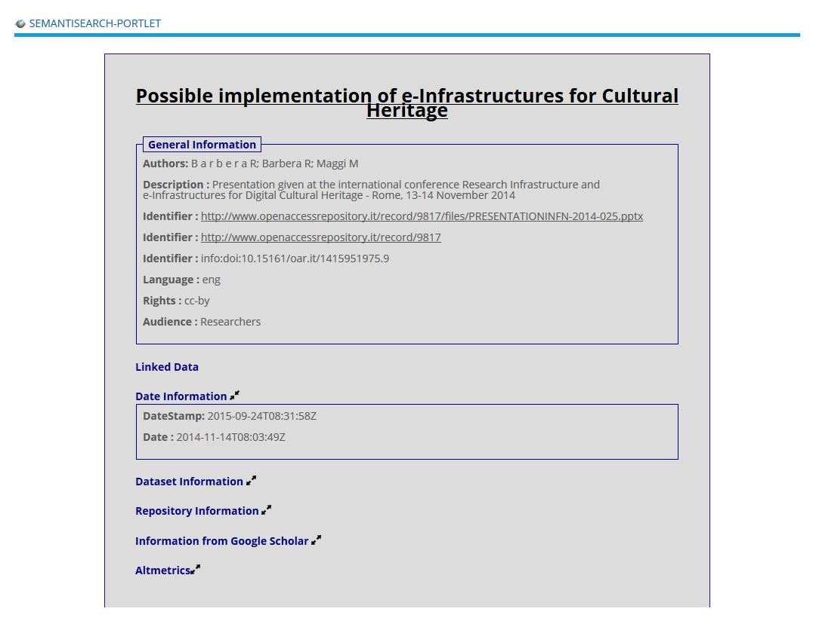
Semantic Search Engine (3)
Detailed information of the selected record from the result list

Slide 12
e-Infrastructure Knowledge Base (KB)
Largest digital information system related to e-Infrastructure
(Now) maintained by the Sci-GaIA project
http://www.sci-gaia.eu/knowledge-base/
e-Infrastructure, sites, services, applications
Information accessible via map or tables
  Open Access Document Repositories (KB-OADR)
  Data Repositories (KB-DR)
  Open Educational Repositories (KB-OER)
Searchable by the Semantic Search Engine (SSE)

Slide 13
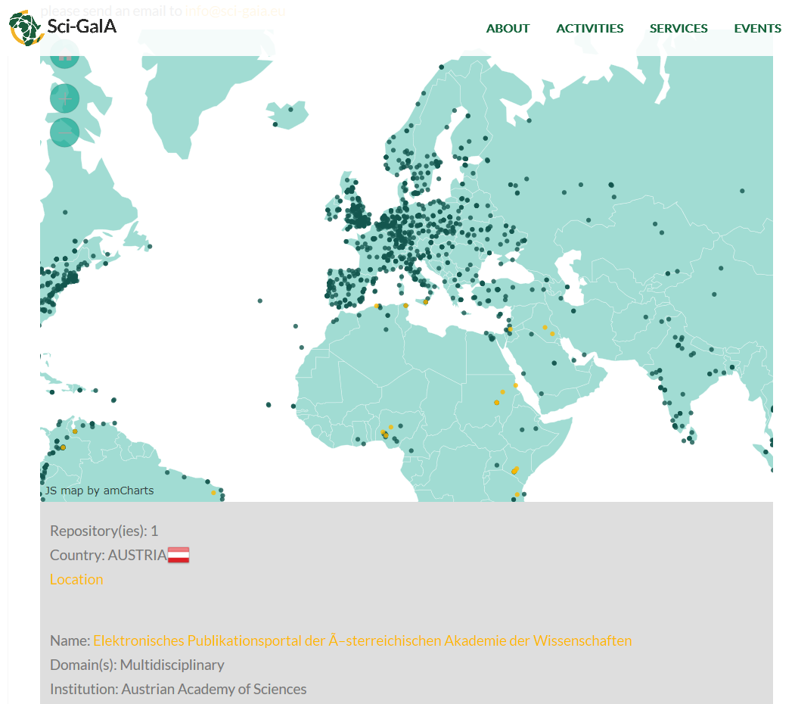
http://www.sci-gaia.eu/knowledge-base/
Map of Open Access Document Repositories
Information of the selected repository

Slide 14
DBO@Cloud (1)
Data originally collected for a project at the Austrian Academy of Sciences, started more than 100 years ago (Dictionary of the Bavarian Dialects in Austria)
> 20 000 records with metadata can be browsed
https://dariah-gateway.lpds.sztaki.hu/web/guest/dbo-portlet
Filter options and customizing of the display possible
Images from the original questionnaires are available

Slide 15
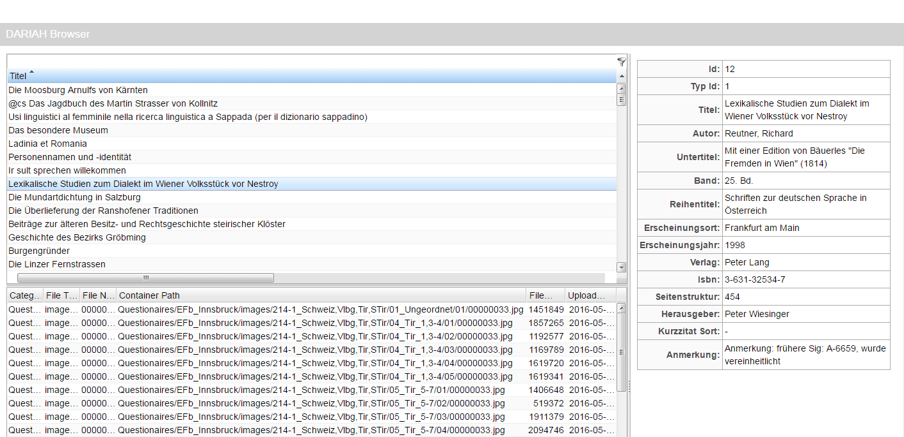
DBO@Cloud (2)
Bibliographical data: full list (upper left) and detailed view (metadata) of the selected record (right) – multimedia resources (lower left)

Slide 16
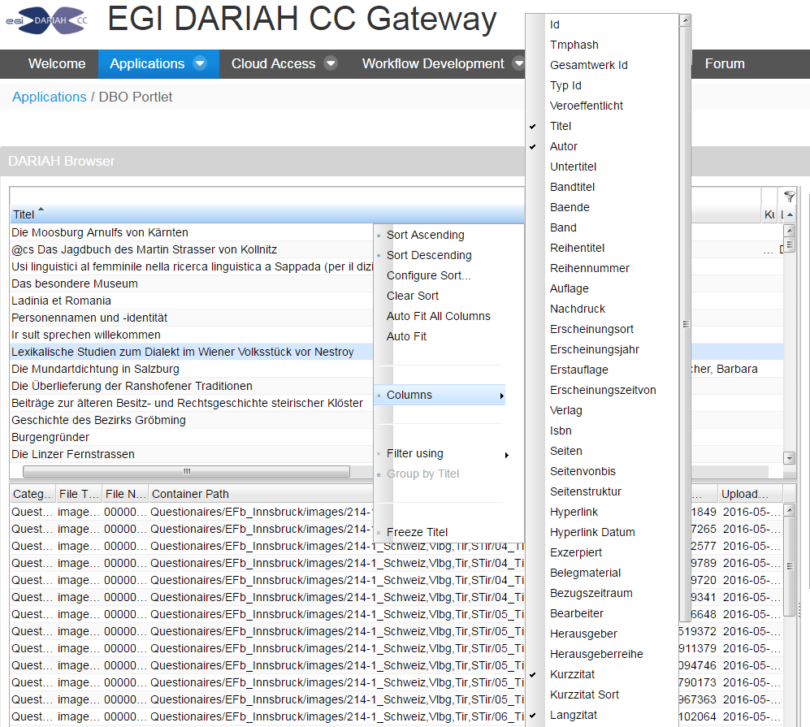
DBO@Cloud (3)
Explore data:
Selecting records by using filter function
Customizing display by adding/removing columns in the list of references

Slide 17
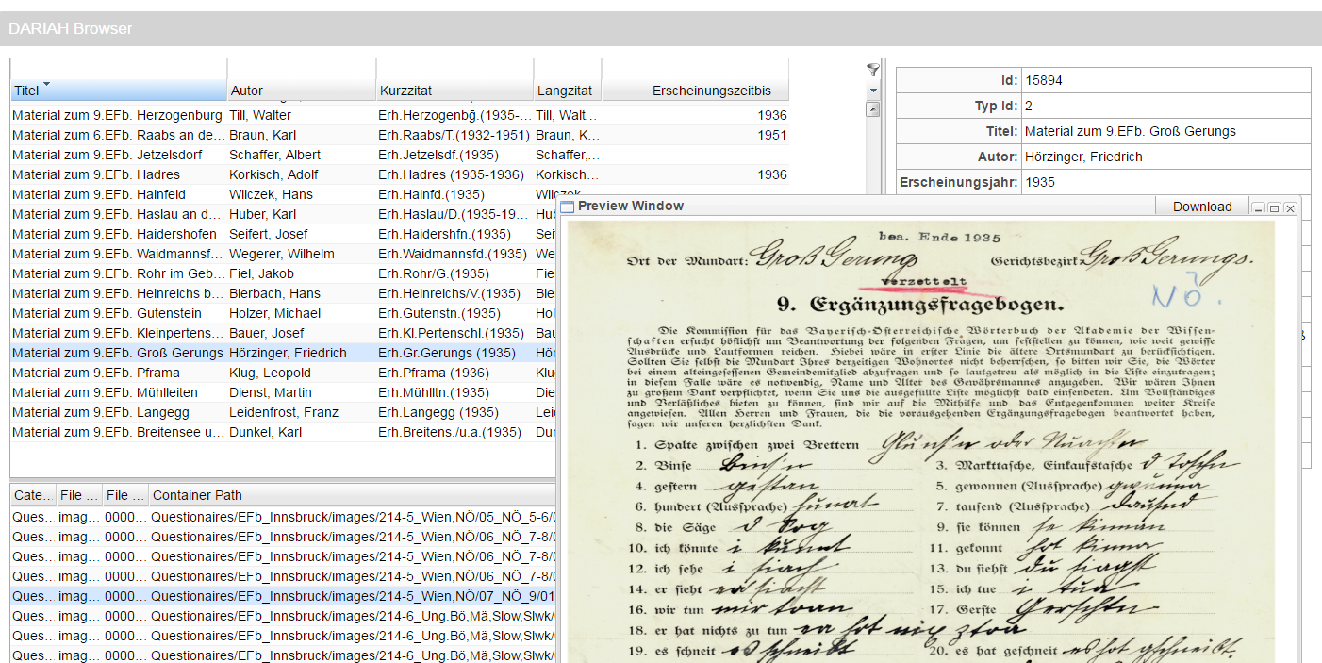
DBO@Cloud (4)
Multimedia-Research: Image – select associated record in full list – receive metadata

Slide 18
Thank you for your attention!
Barbara.Piringer@oeaw.ac.at
www.oeaw.ac.at/acdh

