Slide 1
The Quest for Dictionaries as a Research Tool: a Remarkable Intersection
dirk.kinable@ivdnt.org

Slide 2
The Quest for Dictionaries as a Research Tool: a Remarkable Intersection
Changes in the concept of a dictionary.
Printed dictionaries: traditional ‘vertical’ order → digital, lexical databases: ‘horizontal’ approach: interconnected lemmas and word meanings
Brings the lexicon structure in a specific period to the fore

Slide 3
The Quest for Dictionaries as a Research Tool: a Remarkable Intersection
Great impact on dictionaries as practical research tools for text-oriented disciplines
Opportunities in a distant future or quite readily available?
Two main questions:
Q1. how to interlink lexical content
Q2. how to visualise relationships

Slide 4
The Quest for Dictionaries as a Research Tool: a Remarkable Intersection
Q1&Q2: best put to practice with regard to dictionaries in the ENeL-dictionary portal by means of a concrete case
Many historical, scholarly dictionaries included. Among others, Dutch reference-works

Slide 5
The Quest for Dictionaries as a Research Tool: a Remarkable Intersection
The Barcelona presentation: Middle Dutch Dictionary: illustrated how a multilingual dictionary-portal interlinking entries, e.g. in the vernacular and in Latin, provides cultural insight across languages and enables to evaluate existing text hypotheses: 14th c. play of Winter and Summer

Slide 6
The Quest for Dictionaries as a Research Tool: a Remarkable Intersection
Budapest presentation:
Diptych: second step: with this dictionary and text as a means of demonstration
aim: by addressing Q1 and Q2
providing further insight into the horizontal design of entries in a network structure from a monolingual perspective.
including a test for its strength with regard to the development of new views for text research

Slide 7
The Quest for Dictionaries as a Research Tool: a Remarkable Intersection
The insights presented at Barcelona were based on a lexical database with a still relatively simple semantic structure:
Level: synonymy/hyperonymy/hyponymy
More refined structures: semantic networks, more specifically: wordnets with the Princeton WordNet for English as its paradigmatic model

Slide 8
The Quest for Dictionaries as a Research Tool: a Remarkable Intersection
Cornetto builds on the Princeton WordNet model providing a fine-grained set of semantic relations:
basic relations: synon., hyperon., hypon., anton., meron.
semantical relations with lexical correlates: agent, patient, participant, subevent, cause, location etc.

Slide 9
The Quest for Dictionaries as a Research Tool: a Remarkable Intersection
This is a way to store the lexicon of a language in a semantic network; it is also highly informative of a specific time and culture.
Cornetto: semantic structures for contemporary Dutch
For elementary concepts the basic structure of the semantic graphs can be retained and the nodes may be replaced by their Middle Dutch equivalents.

Slide 10
The Quest for Dictionaries as a Research Tool: a Remarkable Intersection
Filling our wordnet with the Middle Dutch Dictionary and selecting key words from our play (2 criteria: words in texually important extracts and cultural salience):
parlement/ strijt ‘fight’/ camp ‘duel’/
ere ‘honour’/ wreken ‘to revenge’

Slide 11
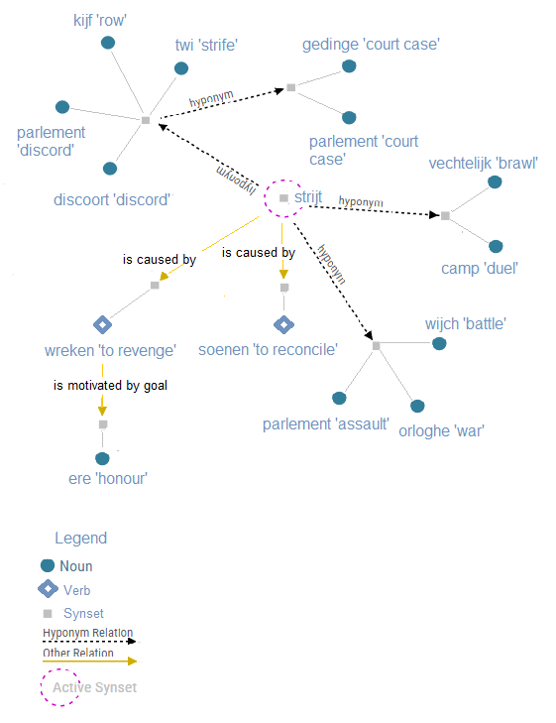
The Quest for Dictionaries as a Research Tool: a Remarkable Intersection

Slide 12
The Quest for Dictionaries as a Research Tool: a Remarkable Intersection
the central node of the keywords: strijt/striden ‘a conflict/to fight’
surrounded by three hyponym synsets and two other semantical relationships, visualising the main options to handle a conflict:

Slide 13
The Quest for Dictionaries as a Research Tool: a Remarkable Intersection
1) direct violent confrontation
2) taking the conflict to court
3) revenge by counteraction and retaliation
4) reconciliation after negotiation or agreement.

Slide 14
The Quest for Dictionaries as a Research Tool: a Remarkable Intersection
Further completion of the nodes with basic relations like antonyms, viz. semantic roles AGENTS, PATIENTS, PARTICIPANTS, SUBEVENTS, CAUSE etc.:→a structured vocabulary with an impressive overview of medieval culture

Slide 15
The Quest for Dictionaries as a Research Tool: a Remarkable Intersection
E.g., gedinge ‘court case’: Participants: (secular court) schepene ‘alderman’; baliu/schoutete ‘bailiff’; taelman ‘pleader’;
(ecclesiastical court) officiael ‘bishop's official’, advocaet ‘lawyer’

Slide 16
The Quest for Dictionaries as a Research Tool: a Remarkable Intersection
E.g., soenen ‘to reconcile’: Subevents: mediation/arbitrage; Participants: paisierers/vreders ‘peace-makers’
E.g., ere ‘honour’; antonym onere/scande ‘dishonour’; words related to their Causes

Slide 17
The Quest for Dictionaries as a Research Tool: a Remarkable Intersection
Two more ways for horizontal systems of online dictionaries to supply information:
linking headwords to concordances from (also non-literary) editions as an extension beyond the example section
meta-comment option for adding bibliographic references on word studies related to entries

Slide 18
The Quest for Dictionaries as a Research Tool: a Remarkable Intersection
Our new-style dictionary provides a term of comparison for the behaviour of our protagonists Winter and Summer
It fits in well with the second option of revenge, often chosen after an offence against honour
Both represented as rich, powerful, of noble birth

Slide 19
The Quest for Dictionaries as a Research Tool: a Remarkable Intersection
The purpose of the duel clearly on both sides: sijn ere verwaren ‘to preserve his honour’and in sijn ere bliven ‘to remain in his honour’ Honour is represented injured by insults.
Desire for revenge first expressed in the verb wreken by Summer because of ‘haughty language’; Winter puts it into practice by his challenge to a duel: calls Summer a liar for an unfounded claim and throws the gauntlet

Slide 20
The Quest for Dictionaries as a Research Tool: a Remarkable Intersection
Course of events not only result of fiction: reflects also what could happen when reputation came under serious pressure: archival record 1408

Slide 21
The Quest for Dictionaries as a Research Tool: a Remarkable Intersection
importance of linked concordances including non-literary sources: entering camp/hantscoe ‘gauntlet’ →relation with historical reality
no terms regarding a juridical settlement of conflict, nor the typical vocabulary of judicial duel
Duel still represented as a particular fight at the initiative of the opponents

Slide 22
The Quest for Dictionaries as a Research Tool: a Remarkable Intersection
Ideologically closer to the old spirit of revenge and honour still part of private law
Testing the text against our lexical network is also revealing for the final development of the plot: duel is imminent -set at dawn- but eventually it never happens…

Slide 23
The Quest for Dictionaries as a Research Tool: a Remarkable Intersection
It is prevented but not in a way reminiscent of the previous common 14th-century practice when authorities could oblige parties to reconcile: cf. terms for official ‘peace-makers’
Course of action corresponds to voluntary reconciliation, more specifically voluntary arbitrage

Slide 24
The Quest for Dictionaries as a Research Tool: a Remarkable Intersection
Correspondences:
Among others:Venus’s own reserved wordings: ‘I will interfere in this dispute and settle it/ if I have the ability to do so’ ≠ judge imposes judgments using the power vested in him

Slide 25
The Quest for Dictionaries as a Research Tool: a Remarkable Intersection
The way the conflict is resolved: question to leave the decision to Venus is directed to both opponents: striking recurrence of the verb bliven
It appears to be a subevent of soenen ‘to reconcile’; the specialist literature of legal history: defined as ‘a unilateral act of submission: to submit oneself voluntarily or involuntarily to the decision of reconcilers’

Slide 26
The Quest for Dictionaries as a Research Tool: a Remarkable Intersection
Ease with which the protagonists drop all hostility: fits in with the medieval tradition that in case of favourable conditions for one’s reputation were present, as request of an esteemed intermediary, honour could be restored by abstaining from violent revenge, showing magnanimity

Slide 27
The Quest for Dictionaries as a Research Tool: a Remarkable Intersection
Wordnets: the necessary size and structure to assess the added value of search systems with interconnected lemmas for voluminous historical dictionaries
Digital interconnection of dictionary-entries and its visualisation allow such progress that an intersection of lexicography and digital humanities has been reached

Slide 28
The Quest for Dictionaries as a Research Tool: a Remarkable Intersection
This development requires scholars of text-oriented disciplines not to limit the function of historical dictionaries to ‘translation devices’
As to lexicographers used to a mainly linguistic perspective, it may hopefully make them aware of the need to produce research instruments to investigate efficiently texts into which cultures have crystallised

