Slide 1
How to produce software for Digital Humanities?
Alejandro Benito Santos
abenito@usal.es

Slide 2
?
Notes:
Good question because I don’t know.
The funny thing is nobody seems to know either.
Question the audience
Sincerely I’m overwhelmed
Instead I will be presenting some of the lessons we learnt during the past months and outlining my yet-to-be-done proposal

Slide 3
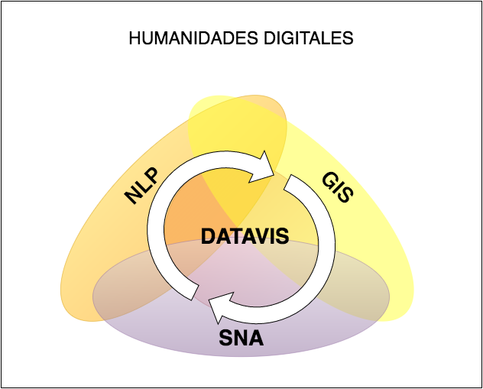
Demystifying the computational powers
NLP
SNA
GIS
DataVis

Slide 4

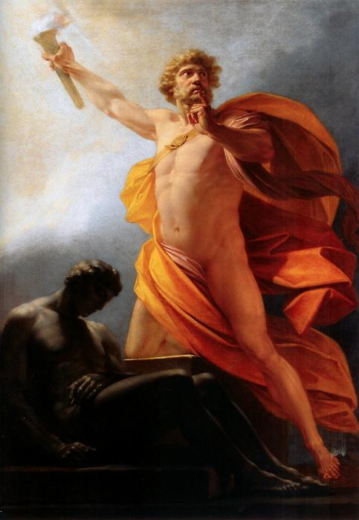
Mighty Computational Powers
Computer Scientist
Humanists
Notes:
We -Computer Scientists- tend to live in our own bubble
As we live in the Information Era we might fall into the false premise that we are able to fix the world just by ourselves.
We sometimes think we are too important
We need to be very careful with technological optimism and take it with a pinch of salt

Slide 5
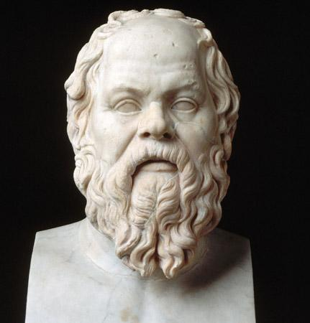

She’s right
You know nothing, Computer Scientist.
Notes:
It is you -Humanists- who have the duty to break this bubble
Gives you a fall sense of authority
We are not researching new computational methods but rather we need to apply them in new, unexpected ways
We need to promote healthy, peer to peer conversations

Slide 6
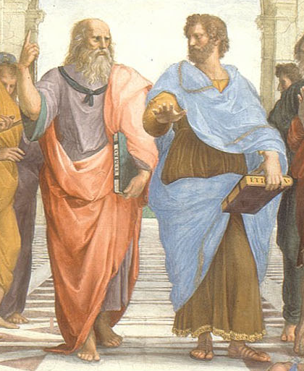
Algorithms, NLP, Graph Theory, SNA, Data Mining, Semantic Web, GIS, DataVis, Machine Learning...
Dialectology, Cultural Diversity, Lexicography, Ethnology, Etymology, History, Disambiguation...
I HATE this guy
This is a WASTE of time
Notes:
We need to make this situation look more like a dialogue instead of two separate.
Sometimes I had the feeling that it took more time to understand what I was dealing with than actually codying it.
I Have the impression that it happens something similar to humanistic scholars
This leaves us with a question:
Is this mess really worth it?

Slide 7
Motivations
Digital Humanities is fun
Overlaps with STEM
Takes advantage of the increasing availability of computational methods
Promotes Information Literacy
  Literacy vs Fluency vs Mastery

Slide 8
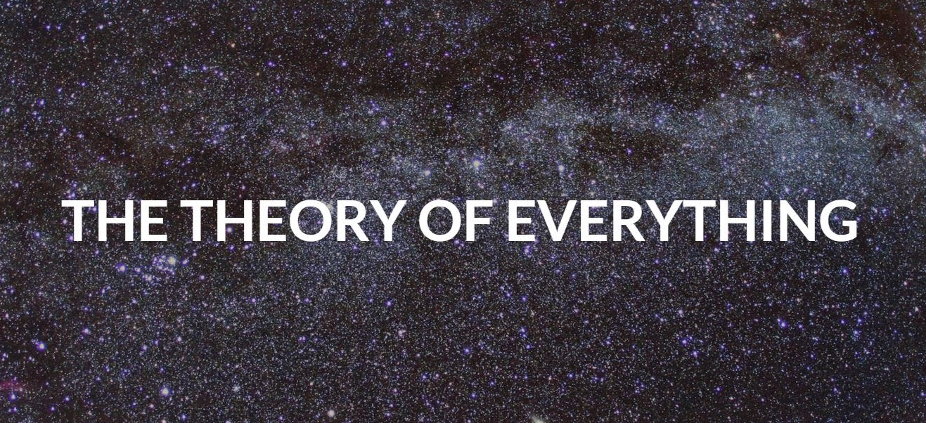
Notes:
As I see it, DH generally is the application of the scientific method to the humanistic research - which hasn’t been done before-

Slide 9
What we have learnt during the past months
Humanistic research is hard and time-consuming.
Some of the questions under investigation are as old as humanity.
It involves many different stakeholders, each one pertaining to one or more sub-areas of expertise.
Research methodologies are usually ad-hoc and bound to a specific problem domain.
Digital Humanities is text-heavy.
There’s a complete lack of sw methodologies

Slide 10
DataVis-driven Humanities Research
Is this problem a generic one?
Can we apply the same methodologies in the DH context that were conceived to solve other problems (banking, gaming or others?)
My view is that we need something else
Notes:
Is this problem a generic one?
Can we apply the same methodologies in the DH context that were conceived to solve other problems (banking, gaming or others?)
My view is that we need something else

Slide 11
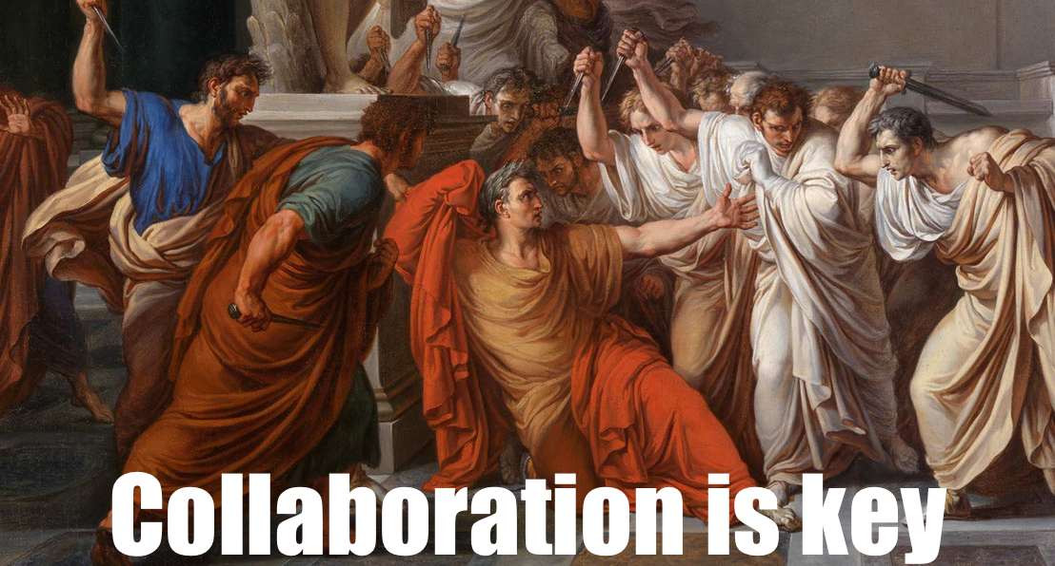
Notes:
We all know

Slide 12
Collaborate, collaborate, collaborate
Enforce academic discussion since the first stages of the research
  We should always have an “open communication channel” with other teams
    Slack
    Skype
    Others
Fast prototyping
  We need a software architecture oriented towards DH that supports it
  How to choose what to prototype? - Design game probably would be a good starting point
Continuous exchange of research artifacts
  Pivot tables? Excel databases? What else?
  Textual description of ad-hoc workflows
Oriented towards the web (Fast publication)
  During the research. High accessibility for all stakeholders
  Short impact time-span → We really need to do something about this

Slide 13
Expose, expose, expose
Keep your CV online.
Generate “social” traction.
  Write damn blog posts
Acknowledge others’ work
Attract interest
Show your prototypes
Talk about UX, usability tests, etc

Slide 14
A DH sw architecture with many problems
ES gives too much throughput
Business logic is deeply bound into the client
Publication is still difficult and it takes longer than it should
It leverages the process of creating visualizations but not much.
It doesn’t implement any kind of user analytics

Slide 15
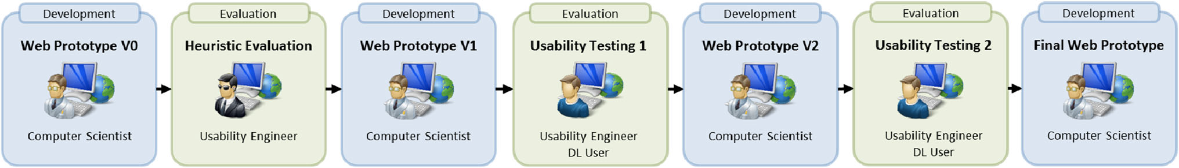
We definitely need something else but what?
We need to work with deltas instead of whole result sets
Employ truly reactive technologies
  React.js?
  Meteor.js?
  Sockets?
Move business logic to the server-side
Conceal implementation details
Really put the focus on the visualizations

Slide 16
Sorry but that was it. Thank you.

