Slide 1
Linguistic Linked Open Data
Insight Center for Data Analytics
National University of Ireland, Galway
John P. McCrae

Slide 2
What is Linguistic Linked Open Data?
Linguistic Data
  Lexicons, Corpora, Typologies, etc.
Linked Data
  Refers to other datasets
  Using (W3C) standards, e.g., RDF
Open Data
  Open licenses, e.g., Creative Commons

Slide 3
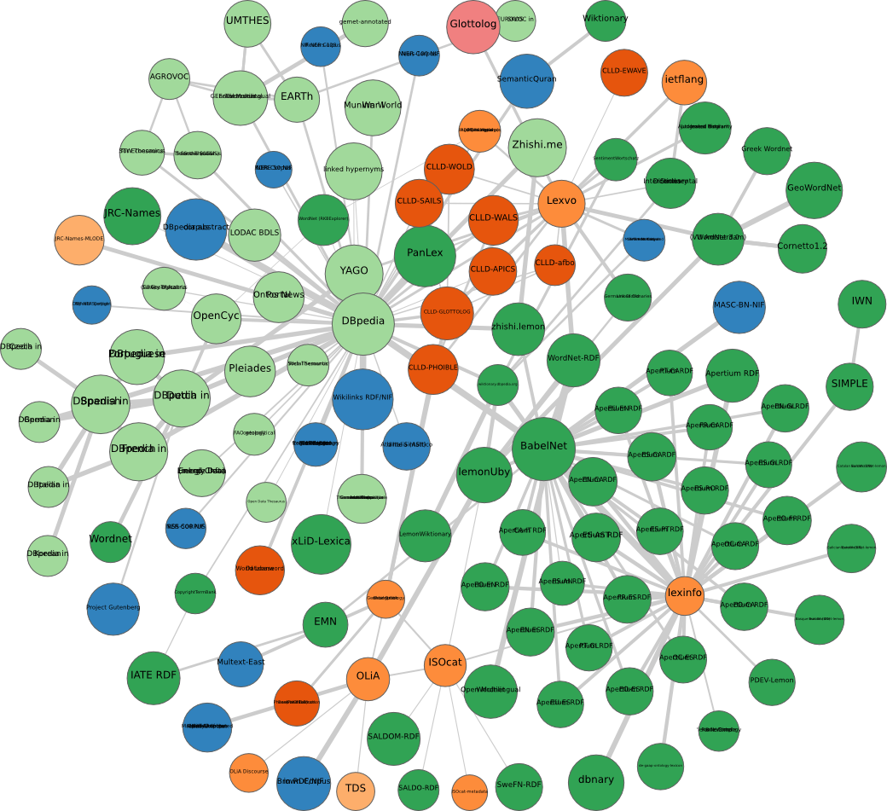
Linguistic Linked Data Cloud

Slide 4
The promise of lexical linked open data
Representation and Modelling
Structural Interoperability
Federation
Ecosystem
Expressivity
Conceptual Interoperability
Dynamic Import
Towards open data for linguistics: Lexical Linked Data. Christian Chiarcos, John McCrae, Philipp Cimiano and Christiane Fellbaum, In: New Trends of Research in Ontologies and Lexical Resources, pp 7-25, (2013).

Slide 5


Representation and Modelling
Claim: Lexical-semantic resources are best described as labeled directed graphs such as RDF.
https://www.w3.org/2016/05/ontolex/

Slide 6
Structural Interoperability
Claim: Using a common data model eases the integration of different resources

Slide 7
Federation
Claim: In contrast to traditional methods, where it may be difficult to query across even multiple parts of the same resource, linked data allows for federated querying across multiple, distributed databases maintained by different data providers
~

Slide 8
Ecosystem
Claim: Linked data is supported by a community of developers in other fields beyond linguistics, and the ability to build on existing tools and systems is clearly an advantage.
~

Slide 9

Expressivity
Claim: Semantic Web languages (OWL in particular) support the definition of axioms that allow to constrain the usage of the vocabulary, thus introducing the possibility of checking a lexicon or annotated corpus for consistency.

Slide 10


Conceptual Interoperability
Claim: The use of globally unique identifiers for concepts or categories can be used to define the vocabulary that we use and these URIs can be used by many parties who have the same interpretation of the concept
~

Slide 11
Dynamic Import
Claim: URIs can be used to refer to external resources such that one can thus import other linguistic resources “dynamically”. By using URIs to point to external content, the URIs can be resolved when needed.
~

Slide 12
Newly identified problems
Availability
Data Quality
Linking
Verbosity

Slide 13
Availability
Problem
Data often becomes unavailable
Solutions
Blockchain and hashes
  Would you be happy to cite your data as HM90xIYzbFRb?
Lots of Copies Keeps Stuff Safe
From Web Addresses => Peer2Peer methods
  Permanent data backup

Slide 14
Data Quality
Problem
Missing links
Invented URIs
Format errors
Incorrect modelling
Solutions
Data seal of approval
LOD Laundromat

Slide 15
Linking (Dictionaries)
Problem
Linking is not easy
Sense disambiguation
Solutions
‘Nearly automatic’ link integration
Linked Data Profiling
More central nodes
  WordNet Interlingual Index

Slide 16
WordNet Interlingual Index
WordNet synset identifier is typically 00001740-n
Means read 1740 bytes into file nouns.index!
Nightmare!
New project by Global WordNet Association
New identifiers: i93115
http://ili.globalwordnet.org/ili/i93115
Fixed ID
Managed by community
Interlingual (must not be lexicalized in English)

Slide 17
Adding concepts to the ILI
Existing wordnet
  Good metadata
  Open license
Novel synset
  Links
  Part-of-speech
  English definition
Verified manually
Duplicate detection

Slide 18
Schema Alignment
Converting and linking datasets is hard. We propose automating it as follows:
(1) Extract Schema from Dataset
Dataset 1
Schema 1
Dataset 2
Schema 2
Aligner
(2) Automatically create converter
(3) Make dataset 2 compatible with dataset 1
Converter + Linker
Dataset 2

Slide 19
NAISC
NAISC Architecture
We are developing the NAISC (Nearly Automatic Integration of SChema) aligner
Duplicate Detection for ILI
Entity 1
Lens
Feature
Extractor
Classifier
Aligner
Entity 2
(1) Extract text from ontology entities, e.g., label or label of all superclasses
(2) Extract numeric features, e.g., longest common substring, deep learning
(3) Classify similarity as supervised regression (using WEKA)
(4) Collect all scores and find global optimal alignment

Slide 20
Verbosity
Let’s just convert everything to RDF!
But:
RDF takes more bytes
RDF Tax
It is not that easy...
Solutions
Stand-off metadata (don’t touch the primary data!)
JSON-LD, CSV-on-the-Web

Slide 21
CSV-on-the-Web
Typical data file, in CoNLL format
1 He he PRON PRP
2 is be VERB VBZ
3 in in ADP IN
4 the the DET DT
5 United unite VERB VBD
6 Kingdom kingdom NOUN NN

Slide 22
CSV-on-the-Web (II)
Metadata about the resource
{
"@context": "http://www.w3.org/ns/csvw",
"dc:license": "http://opendefinition.org/licenses/cc-by/",
"dialect": {
"delimiter": "\t" },
"tableSchema": {
"columns": [{
"name": "ID",
"dc:description": "The increasing identifier of each word",
"propertyUrl": "dc:identifier"
},
…
}]
}
Information about parsing
Column Name
and Description
RDF Property

Slide 23

A unified interface to lexical data
CSV, TSV etc.
+
CSV-on-the-Web metadata
HTML
Linked
Data
XML, JSON, etc.
+
JSON-LD Context
SPARQL
RDF
(XML, Turtle, NT, JSON-LD)
JSON API

Slide 24
Conclusion
Linked data is better data
Quality is better (format, verification)
Access is better
A little semantics goes a long way
Linking is documenting
ELEXIS should focus on making this easier:
  Automated linking
  Metadata generation
  Visualisation and interfaces

Slide 25

LANGUAGE, DATA and KNOWLEDGE 2017
Conference in Galway, Ireland
Important Dates
12 October - Call for Papers
9 February - Paper Submission
30 March - Notifications
19-20 June - Conference
Natural Language Processing
+
Data Science
http://www.ldk2017.org/

