Slide 1
Applying Lexical Resources for Semantic Processing
Bolette Sandford Pedersen
Centre for Language Technology, Department of Nordic Research, Univ. of Copenhagen
bspedersen@hum.ku.dk

Slide 2
Contents
Presentation – who are we?
Reusing and linking semantic lexical resources (DanNet, FrameNet, WordTies)
The SemDax Corpus, a semantically annotated corpus for semantic processing
Contributions to the ELEXIS consortium

Slide 3
Presentation: Who are we?
Centre for Language Technology: A section at the University of Copenhagen
Staff of approx. 15: mix of computational linguists and data scientists
Teaching and research activities at the Centre organized around several themes
Research themes:
Machine learning approach to language processing
language resources (adaption and development)
cognitive modeling and multimodal communication
applications (information retrieval, question-answering, machine translation)
digital humanities infrastructures (i.e. CLARIN)

Slide 4
Presentation: Who are we?
More specifically on language resources:
Research and development within the field of computational lexicography
Main focus: to provide the HLT field with methodologies for reusing lexicographical resources and converting high quality lexicographical resources to formal lexica suitable for HLT
Special focus on lexical semantics, sense inventories, sense clusters etc.
Close collaboration with the Society for Danish Language and Literature (Det Danske Sprog- og Litteraturselskab)

Slide 5
Reusing and linking lexical resources
The Danish Dictionary The Danish Thesausrus
Semantic corpus of Danish
Danish wordnet
Common sense id number
SemDax
Danish FrameNet

Slide 6
Reusing and linking lexical resources
DSL
The Danish Dictionary The Danish Thesausrus
Semantic corpus of Danish
Danish wordnet
Common sense id number
SemDax
Danish FrameNet

Slide 7
Reusing and linking lexical resources
DSL
The Danish Dictionary The Danish Thesausrus
Semantic corpus of Danish
Danish wordnet
Common sense id number
SemDax
Danish FrameNet
DSL + UCPH

Slide 8
Reusing and linking lexical resources
The Danish Dictionary The Danish Thesausrus
Semantic corpus of Danish
Danish wordnet
Common sense id number
SemDax
Danish FrameNet

Slide 9
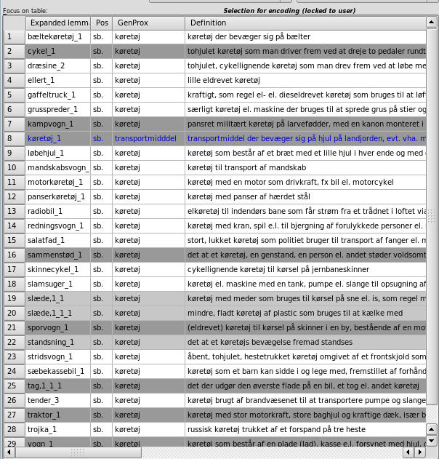
From DDO to DanNet: Genus proximum

Slide 10
Readjustment of inconsistent or underspecified hyponymies
Example: fruits and vegetables
Different definitions from The Danish Dictionary:
tomato is a fruit and a vegetable
aubergine is a vegetable
beetroot is a root vegetable
spinach is a plant
rhubarb is a stalk
artichoke is a flower bud

Slide 11
Readjustments..
Natural taxonomy:
plante (plant)
skærmplante (umbelliferous plant)
rod (tuber)
stilk (stalk)
..
indvolde (entrails)
Food taxonomy:
grøntsag (vegetable)
rodfrugt (root vegetable)
krydderurt (spice herb)
suppeurt (potherb)
..
fjerkræ (poultry)
flæsk (pork)
indmad (offals)

Slide 12
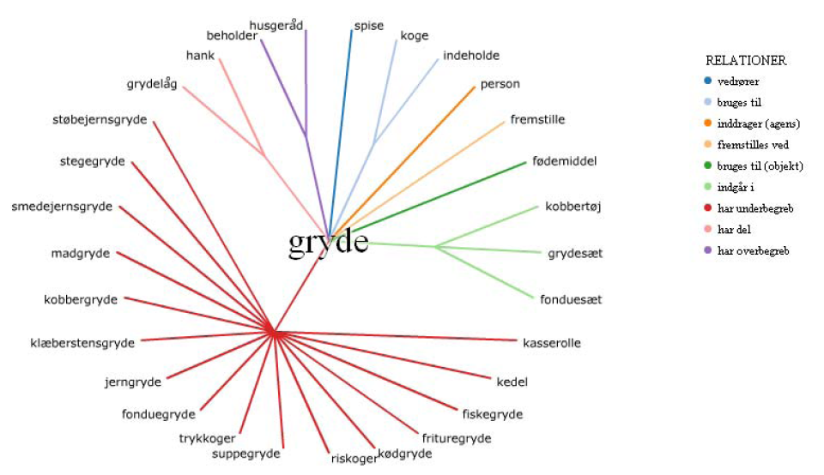
Wordnet relations from definitions
Definition of ”pot”: Container, usually with two handles and a lid used for cooking food

Slide 13
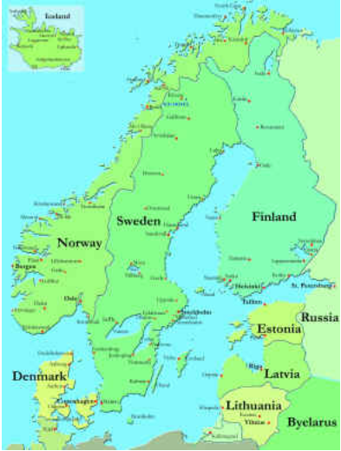
WordTies – linking wordnets across languages

Slide 14
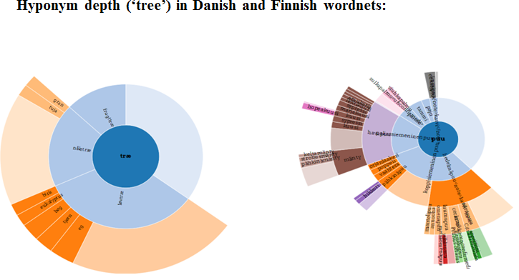
WordTies - linking wordnets across languages
http://wordties.cst.dk/
Aim: METANET/CLARIN initiative: to establish an infrastructure for Nordic wordnets in order to be able to compare and validate them across languages.

Slide 15
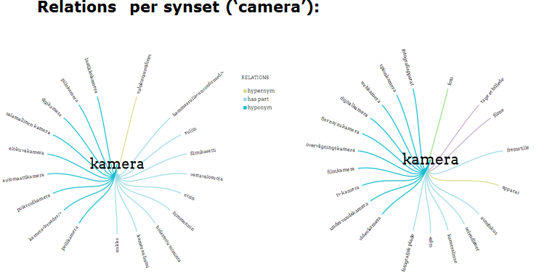
WordTies - linking wordnets across languages

Slide 16
From thesaurus to FrameNet
The Danish Dictionary The Danish Thesausrus
Semantic corpus of Danish
Danish wordnet
Common sense id number
SemDax
Danish FrameNet

Slide 17
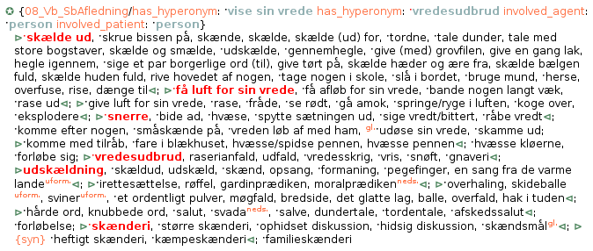
From thesaurus to FrameNet
Communicator Addressee Reason
Den ungarske landstræner havde talt med store bogstaver til sine spillere i pausen
Jeg skælder hende ud for at være groft uansvarlig
I debatten tordnes der løs mod Det kgl. Teaters repertoire

Slide 18
SemDax – a corpus for semantic processing
The Danish Dictionary The Danish Thesausrus
Semantic corpus of Danish
Danish wordnet
Common sense id number
SemDax
Danish FrameNet

Slide 19
SemDax - a corpus for semantic processing
A Danish human-annotated corpus annotated with sense inventories of different granularity based on our sense inventory
Available at: https://github.com/coastalcph/semdax
Aims:
To assess the reliability of the different sense annotation schemes for Danish based on existing resources
To serve as training and test data for machine learning algorithms with the practical purpose of developing sense taggers and semantic role labelling for Danish.

Slide 20
Scalable sense inventories in SemDax
Informativeness Cross-linguality
Coarse-grained Language independent
Named entities
Supersenses (generalised senses)
Clusters of DDO/DanNet senses
Full sense inventory from DDO
Fine-grained Language specific

Slide 21
SemDax - a corpus for semantic processing
New approach to semantic corpus annotation
Not all disagreement is noise: contains valuable linguistic information that can improve annotation schemes and learning algorithms
Double annotation of a larger part of corpus than usually seen
The available corpus includes not only adjudicated files but also diverging annotations

Slide 22
SemDax - a corpus for semantic processing
SemDaX-Coarse
All-words annotation (nouns, verbs, adjectives)
Annotated with so-called supersenses derived from the list of WordNet’s lexicographical files.
Size: 90,000 words
60 % doubly annotated and adjucated
The annotation process
Mapping of DanNet synsets to the 44 supersense classes (based on top level of Princeton Wordnet)
Further specification of supersense set
Establishing a set of satellite tags to enable annotation of multiword lexical units (phrasal verbs (PART), reflexive verbs (REFL), and verbal collocations (COLL))

Slide 23
SemDax - a corpus for semantic processing
Fig. 1. Phrasal verbs with more than one particle (se ud til ('seem')) are annotated as collocations
with the sense label (here: verb.cognition) on the lexical kernel (se).

Slide 24
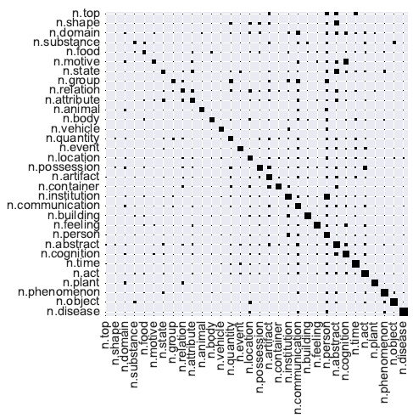
SemDax - a corpus for semantic processing
Evaluation: Where do annotators disagree?

Slide 25
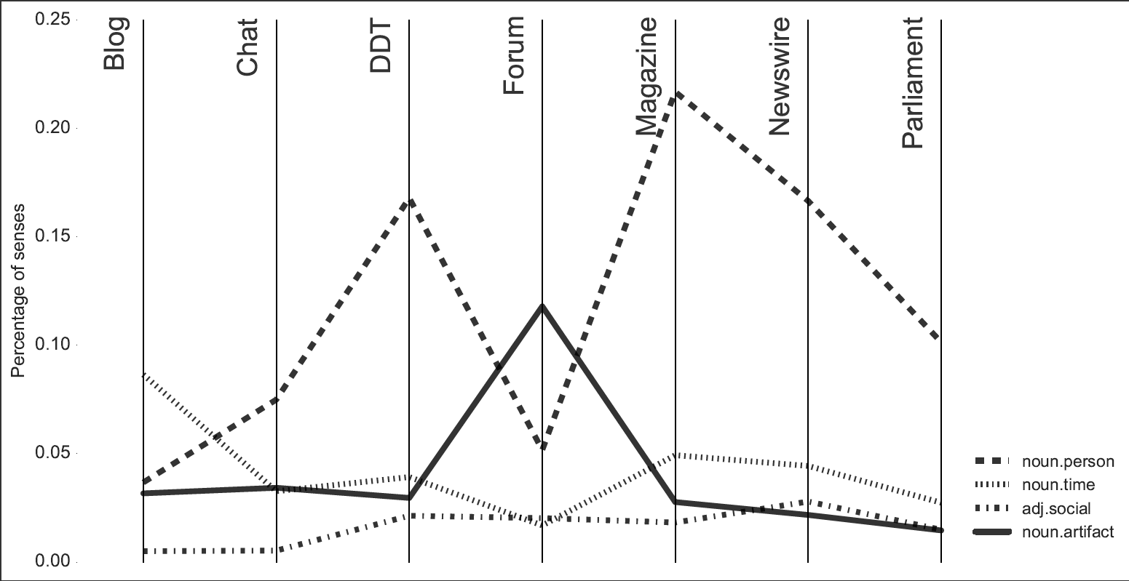
SemDax - a corpus for semantic processing
Evaluation: How do text types differ?

Slide 26
SemDax - a corpus for semantic processing
SemDaX-LexicalSample
Sense annotation of 20 highly ambiguous nouns (11 senses on average)
Sense inventory derived from 1) The Danish Dictionary (DDO) and 2) DanNet combining main and subsenses from DDO and the top-ontological types from DanNet
Clustering method: a reduction of senses of 23.5 % on average

Slide 27
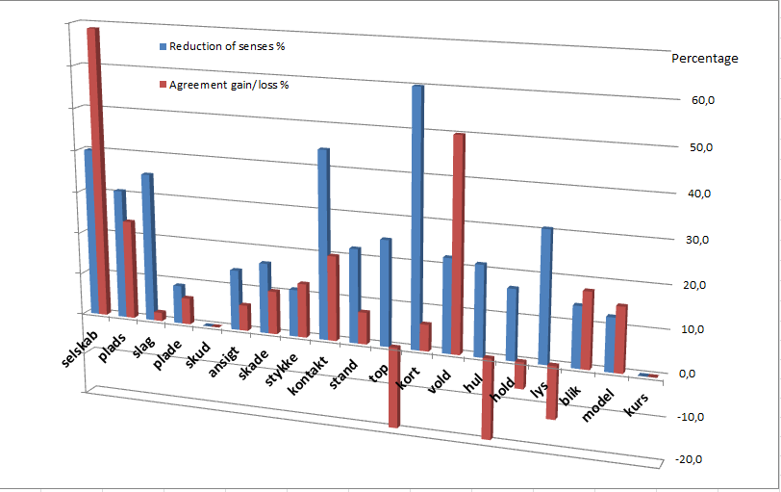
SemDax - a corpus for semantic processing
SemDaX-LexicalSample
Improvement of inter-annotator agreement with the reduced sense inventory: 68 % of the nouns
Average agreement score: full sense inventory 0.52 (Krippendorff’s α), clustered senses 0.56
Individual behaviour: agreement scores from 0.048 for plade (plate, sheet, disc, etc.) to 0.84 for kurs (course, exchange rate, price, track, etc.)

Slide 28
SemDax - a corpus for semantic processing
Close interaction with machine learning group
Development of a sense tagger:
The corpus has been used for training and testing of a sense tagger that achieves an overall F1 score of 0.82 on heldout data, considering only the F1 of supersense labeling, micro-averaged score is ~0.65
Available at: https://github.com/coastalcph/dsl_semtagger
Ongoing: FrameNet lexicon and annotations on the same corpus
Purpose: Semantic role labeling

Slide 29
Contribution to ELEXIS Consortium
Many years of experience in:
restructuring “traditional” lexica for HLT purposes (“cross-disciplinary fertilization”)
focus on lexical semantics: sense definitions, sense distinction, sense inventories, sense clusterings
close interaction with developers/machine learning community: the need for large, consistent resources
focus on language banks for lesser resourced languages/language transfer processes
Semantic processing: Word sense disambiguation, semantic role labeling
focus on strategies and standards for extracting, structuring and linking of lexicographical resources
multilingual resources, standards, tools
open access approach
Crowd sourcing experience

Slide 30
Two more lexical resources

Slide 31
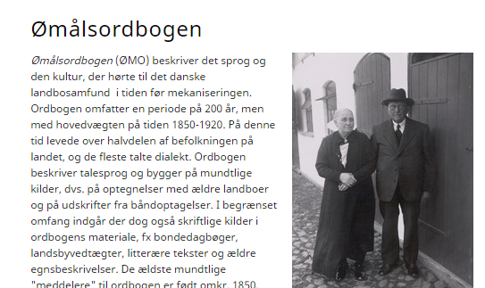
Two more lexical resources Danish Dialect Dictionary

Slide 32
Selected links
DanNet: http://wordnet.dk/lang.html
SemDax:https://github.com/coastalcph/semdax
WordTies: http://wordties.cst.dk/
Sense tagger: https://github.com/coastalcph/dsl_semtagger

Slide 33
Selected ref. on DanNet, SemDax, FrameNet etc.
Pedersen, B.S., A.Braasch, A. Johannsen, H. Martínez Alonso, S. Nimb, S. Olsen, A. Søgaard, N. H. Sørensen (2016) The SemDaX corpus – sense annotations with scalable sense inventories. In 2016 LREC Proceedings, Portorož, Slovenia.
Nimb, S.; B.S. Pedersen (2015). Fra begrebsordbog til sprogteknologisk ressource: verber, semantiske roller og rammer – et pilotstudie. In: 13. Konference om Leksikografi i Norden ,University of Copenhagen, Denmark.
Pedersen, B.S., S.Nimb, S.Olsen, A.Søgaard, N.Sørensen (2014) Semantic Annotation of the Danish CLARIN Reference Corpus. Proceedings from isa-10, 10th Joint ACL - ISO Workshop on Interoperable Semantic Annotation p. 25-29, Reykjavik, Iceland.
Pedersen, B.S. (2013). Coding semantic properties of words in computational dictionaries. In: Gouws, Heid, Schweickard, Wiegand (Eds.): Dictionaries: An International Encyclopedia of Lexicography Supplementary volume: Recent Developments with Focus on Electronic and Computational Lexicography. Berlin: Walter de Gruyter
Fellbaum, C., B.S. Pedersen, M. Piasecki and S.Szpakowicz (eds.) (2013). Special Issue on Wordnets and Relations, Language Resources and Evaluation Vol. 27 no. 3. Springer.
Nimb, S. B.S. Pedersen, A.Braasch, N. H. Sørensen and T.Troelsgård (2013). Enriching a wordnet from a thesaurus. Workshop Proceedings on Lexical Semantic Resources for NLP from the 19th Nordic Conference on Computational Linguistics.(NODALIDA). Linköping Electronic Conference Proceedings; Volume 85 (ISSN 1650-3740)
Pedersen, B. S. (2012): Lexicography in Language Technology. Invited talk in Proceedings of the 15th EURALEX International Congress pp.31-47, Oslo, Norway http://www.euralex.org/elx_proceedings/Euralex2012/pp31-46%20Pedersen.pdf
Pedersen, B.S., L. Borin, M. Forsberg, K. Lindén, H. Orav, E. Rögnvalssson (2012) Linking and Validating Nordic and Baltic Wordnets- A Multilingual Action in META-NORD. In: Proceedings of 6th International Global Wordnet Conference pp.254-260. Matsue, Japan.
Pedersen, B.S, J. Wedekind, S. Kirchmeier-Andersen, S. Nimb, J.E. Rasmussen, L.B. Larsen, S. Bøhm-Andersen, H.Erdman Thomsen, P. J. Henrichsen,J. O. Kjærum, P. Revsbech, S.Hoffensetz-Andresen, B. Maegaard (2012). The Danish Language in the Digital Age - Det danske sprog i den digitale tidsalder. META-NET White Paper Series, Springer Verlag.
Pedersen, B.S. (2010). Releasing lexical resources as open source: pros and cons. In: Proceedings from 2nd European Language Resources and Technologies Forum. Barcelona, Spain p. 48-50.
Pedersen, B.S. (2010). Semantiske sprogressourcer - mellem sprogteknologi og leksikografi. In Lorentzen & Fjeld (Eds.): LexicoNordica Vol. 17 pp. 163-181.
Pedersen, B.S. (2010). Lexicography and Language Technology in the Nordic countries. Report from a Symposium in Copenhagen January 29 to 31, 2010 . In: Euralex Newsletter, International Journal of Lexicography Vol. 23. No. 2, pp 249-254.
Pedersen, B.S, S. Nimb, J. Asmussen, N. Sørensen, L. Trap-Jensen, H. Lorentzen (2009). DanNet – the challenge of compiling a WordNet for Danish by reusing a monolingual dictionary. Language Resources and Evaluation, Computational Linguistics Series, pp.269-299. http://link.springer.com/article/10.1007%2Fs10579-009-9092-1

