Slide 1
ELEXIS
European Lexicographic Infrastructure
Call: Integrating Activities for Starting Communities
INFRAIA-02-2017

Slide 2
Call: INFRAIA-02-2017
Types of action: RIA Research and Innovation action
Deadline Model: two-stage
1st stage Deadline: 30 March 2016 17:00:00
2nd stage Deadline: 29 March 2017
Work Programme Part: European Research Infrastructures (including e-Infrastructures)
Duration: 4 years
Budget: 5M EUR
Results: 3 months (1st stage)

Slide 3
Abstract – access, bridge the gap
The project proposes to integrate, extend and harmonise national and regional efforts in the field of lexicography, both modern and historical, with the goal of creating a sustainable infrastructure which will
enable efficient access to high quality lexical data in the digital age, and
bridge the gap between more advanced and lesser-resourced scholarly communities working on lexicographic resources.
The need for such an infrastructure has clearly emerged out of the lexicographic community within the European Network of e-Lexicography COST Action which will end in 2017.

Slide 4
NLP, LOD, SW
Current lexicographic resources, both modern and historical, have different levels of structuring and are not equally suitable for application in other fields, e.g. Natural Language Processing. The project will develop strategies, tools and standards for extracting, structuring and linking lexicographic resources to unlock their full potential for Linked Open Data and the Semantic Web, as well as in the context of digital humanities.
The project will help researchers create, access, share, link, analyse, and interpret heterogeneous lexicographic data across national borders, paving the way for ambitious, transnational, data-driven advancements in the field, while significantly reducing a duplication of effort across disciplinary boundaries.

Slide 5
Consortium, CLARIN, DARIAH
ELEXIS will be carried out by a balanced consortium with distributed geographical origins. It is composed of content-holding institutions and researchers with complementary backgrounds - lexicography, digital humanities, language technology and standardisation - a crucial feature required to address the multi-disciplinary objectives of the project. In cooperation with CLARIN and DARIAH, it will focus on defining and providing common interoperability standards, workflows, conceptual models and data services as well as training and education activities focusing on user needs and cross-disciplinary fertilisations.

Slide 6
Impact: Efficient access and user needs
lexicographic communities working on scholarly and language standardisation dictionaries will gain access to
  modern and retrodigitised historical lexicographic data,
  large amounts of linked and integrated semantic data and
  extracted structured data from text corpora and multimodal resources,
  online training materials in DARIAH services,
  networking events (meetings, conferences, workshops).
computational linguistics and language resources communities will gain access to currently inaccessible data from quality lexicographic resources and interlinked semantic data, as well as extracted data from corpora and multimodal resources;
digital humanities communities will gain simplified and efficient access to modern and historical lexicographic resources as cultural and historical artefacts, supporting research in a wide area of humanities disciplines such as history, religion, gender studies, literature and education.

Slide 7
Impact: Inter-infrastructure synergies and optimisation
currently isolated European language infrastructures working on lexical description of individual languages in national language institutes and standardisation bodies will be joined in one pan-European infrastructure;
close links and synergies will be established between CLARIN and DARIAH, with ELEXIS working on top of existing services provided by both as a new user community.

Slide 8
Impact: Innovation and industry
industrial partners in ELEXIS will be able to take the role of intermediaries between research and industry in language technology and language learning, as well as lexicography and lexical content publishing in general. Interest of industry is visible from participating partners and from the letter of interest by an important stakeholder in the field;
information from quality lexicographic resources and interlinked semantic data will be opened up and made available for use in commercial scenarios, based on ELEXIS work on IPR issues currently hindering the accessibility of the data;
lexicographic data will be evaluated by industry-supported data seal of approval.

Slide 9
Impact: Research and education
online training courses on innovative e-lexicography with suggested ECTS produced by education partners (from universities) will be incorporated into existing curricula,
language teaching and language learning communities will be able to develop and use new improved training materials, based on the (open) access to lexica interlinked on a large scale.

Slide 10
Impact: Cross-disciplinary fertilisations, academia and industry
both computational linguistics and lexicography will be able to achieve a higher level of language description and text processing in a virtuous cycle of cross-disciplinary exchange of knowledge and data;
research or study of lexica in linguistic studies and related disciplines will be enabled by massive interlinking of previously isolated lexicographic resources, which can lead to new discoveries, particularly in the semantic domain;
in humanities disciplines, such as history, religion, gender studies, literature and education, new resources and services can be used for cross-lingual studies, based on interlinked and integrated semantic data;
artificial intelligence systems will be able to make use of lexicographic data in repositories, interlinked semantic data and extracted data from multilingual and multimodal resources.

Slide 11
Impact: Integration of knowledge-based resources 1
previously non-integrated modern and historical lexicographic resources available as isolated incompatible data will be linked, integrated and enriched on different levels. A scalable, multilingual and multifunctional, language resource will be created by:
➔ linking resources: this means providing links between different elements of dictionary entries (lemmas/headwords, senses, definitions, multi-word expressions, etymologies, etc.) enabling any dictionary (element) to be linked with all other dictionaries (or dictionary elements).
Result: a growing network of existing dictionaries linked across common concepts via a huge (multilingual) index.

Slide 12
Impact: Integration of knowledge-based resources 2
➔ integrating resources: this means taking information from individual resources and putting them together in a new resource / aligning them to create a combined resource.
  Result: any combination of existing (linked) resources resulting in a new resource available for immediate use or as a starting point for creating a novel individual lexicographic resource.
  Example: http://www.dwds.de/ (cf. Geyken, Vossen) - DWDSWB, WDG and EtymWB are completely aligned and the alignment is actively exploited on the project’s website to achieve a synchronised display of equivalent lexical entries. This makes it possible to use EtymWB as an etymological extension to the synchronous view of the present-day dictionaries.

Slide 13
Impact: Integration of knowledge-based resources 3
➔ enriching resources with multimodal data (image, sound, video), and unstructured text (corpora, news feeds, social media etc.)
Result: a portal with cross-lingual, cross-media information on word usage.
Example: X-LIKE (http://www.xlike.org/, http://eventregistry.org/) and X-LIME (http://xlime.eu/) projects working on extracting knowledge from different media channels and languages and relating it to cross-lingual, cross-media knowledge bases. In case of ELEXIS, “knowledge” is focused on lexicographic description.

Slide 14
Impact: Integration of knowledge-based resources 4
ultimate goal: a universal (integrated and enriched) registry/network of semantic relations used as a semantic intermediary language for global knowledge exchange, focused on difficult polysemous vocabulary (single-word and multi-word), modern and historical; the realisation of a universal lexicographic metastructure; a matrix dictionary spanning across languages and time.

Slide 15
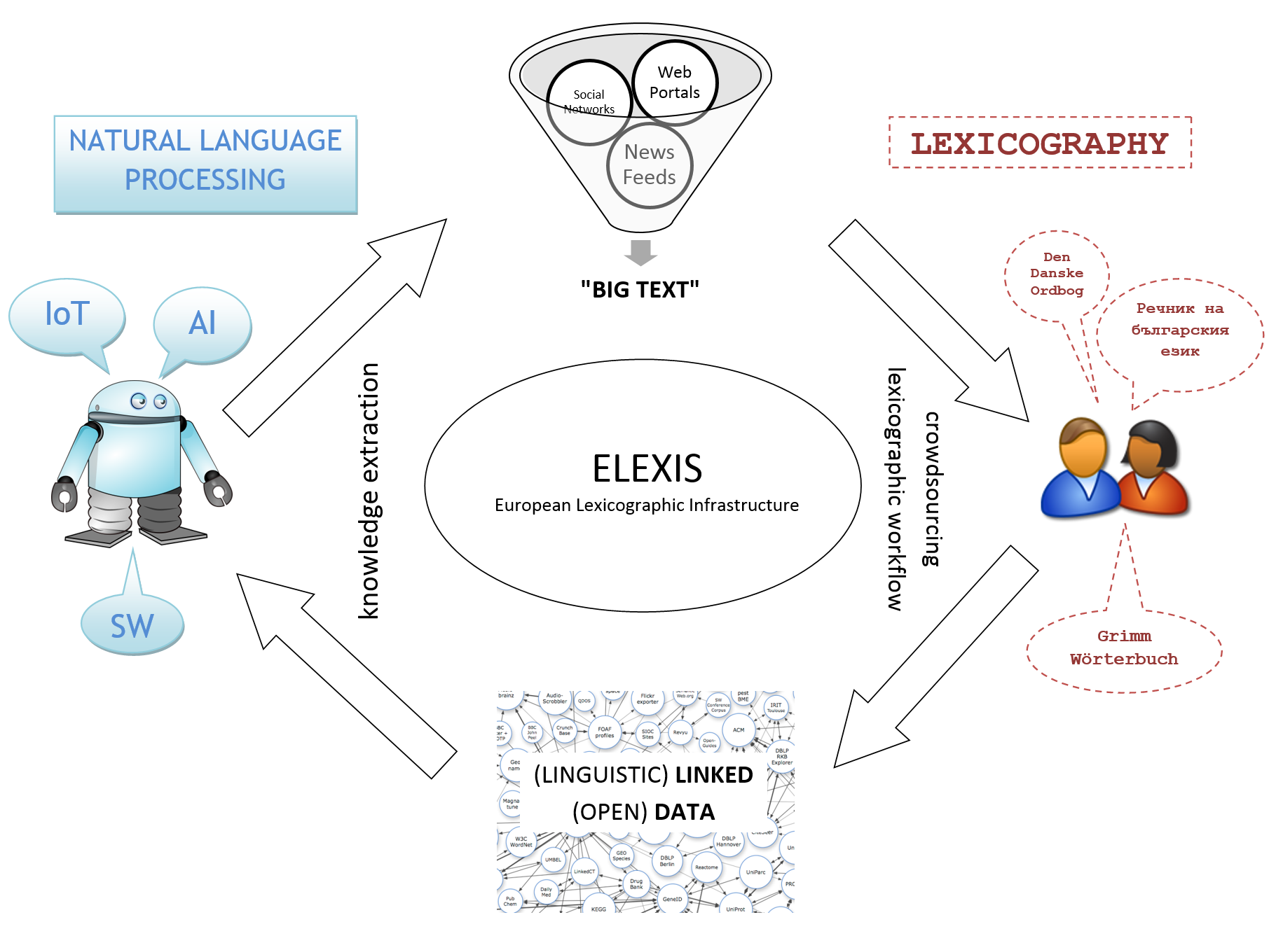
Virtuous cycle of e-lexicography

Slide 16
Consortium 1
Providers of lexicographic data and expertise:
  Institute for Dutch Language, Leiden, Netherlands (Carole Tiberius)
  Danish Society for Language and Literature, Copenhagen, Denmark (Lars Trap-Jensen)
  K Dictionaries, Tel Aviv, Israel (Ilan Kernerman)
Providers of lexicographic data and computational linguistics expertise:
  Institute for Bulgarian Language “Prof. Lyubomir Andreychin”, Sofia, Bulgaria (Svetla Koeva, Diana Blagoeva)
  Research Institute for Linguistics, Hungarian Academy of Sciences, Budapest, Hungary (Tamas Varadi)
  Institute for Computational Linguistics “A. Zampolli”, Pisa, Italy (Monica Monachini)

Slide 17
Consortium 2
Standardisation partners:
  Faculty of Social Sciences and Humanities, Universidade Nova de Lisboa, Lisbon, Portugal (Rute Costa)
Digital humanities, training and outreach partners:
  Austrian Academy of Sciences, Austrian Centre for Digital Humanities, Vienna, Austria (Eveline Wandl-Vogt)
  Belgrade Center for Digital Humanities, Belgrade, Serbia (Toma Tasovac)

Slide 18
Consortium 3
Technology partners:
  Artificial Intelligence Laboratory, Jožef Stefan Institute, Ljubljana, Slovenia (Simon Krek, Marko Grobelnik, Tomaž Erjavec, Iztok Kosem), leading partner
  Sapienza University of Rome, Italy (Roberto Navigli)
  Insight Centre for Data Analytics, National University of Ireland, Galway, Ireland (John McCrae, Paul Buitelaar)
  University of Saarland, Saarbrücken, Germany (Thierry Declerck)
  Lexical Computing CZ s.r.o., Brno, Czech Republic (Miloš Jakubiček)

Slide 19
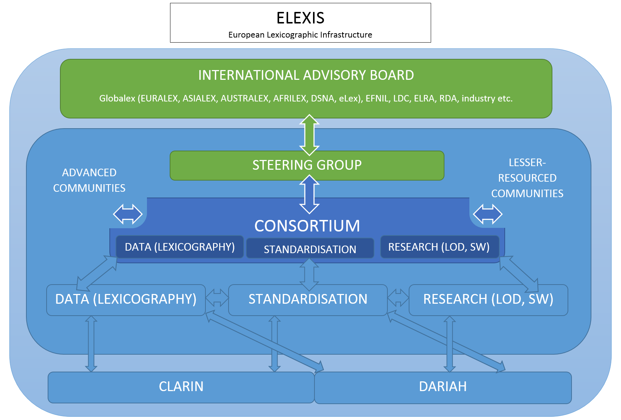

Slide 20
Questions
simon.krek@ijs.si
simon.krek@guest.arnes.si

