Slide 1
Citizen Science – an innovative way to engage
ENEL Meeting WG1
Maria Schrammel, Centre for Social Innovation

Slide 2
Overview
What is Citizen Science and how do the concepts differ from each other?
Which successful projects are there and how are they conceptualised ("citizen driven" versus "science driven")?
ExploreAT – Citizen Science in lexicography – possible approaches.
Notes:
In this presentation I will give an overview on how the single concepts in Citizen Science differ from each other, and I will provide some examples for successful projects and discuss first thoughts about the ExploreAT project, which will start in April.

Slide 3
Definitions: Citizen Science
In general: Citizen Science includes Non-Scientists into authentic scientific processes.
„There is no single definition of Citizen Science but rather a series of definitions that reveal the dynamics of this research approach which is continually evolving and implies new collaborative activities and shared objectives between the main stakeholder groups.“
(Kieslinger & Holocher-Ertl, 2014)
Notes:
In general Citizen Science refers to general public engagement in scientific research activities when citizens actively contribute to science either with their intellectual effort or surrounding knowledge or with their tools and resources.
Still, there is no single definition of Citizen Science but rather a series of definitions that reveal the dynamics of this research approach which is continually evolving and implies new collaborative activities and shared objectives between the main stakeholder groups.

Slide 4
Science
Socio-ecological Systems
Scientific knowledge
Support in data collection and
analysis
Development of new research
fields at the interface of natural,
social and cultural phenomena.
Assured principles and
approaches for intervention
Power of review; monitoring
Ownership and co-determination
Opportunity for innovation
Individual Participants
New knowledge and skills in the
field of research
Understanding scientific
processes
Joint responsibility in solving
essential questions
Value of
Citizen Science
Notes:
What‘s the added value of Citizen Science?
There are three fields benefitting from Citzen Science. Starting with Science itself it has to be mentioned that Citizen Science helps to answer new research questions through a common view on social, cultural and natural phenomenons and through collaborative used resources such as cognitive skills, technical infrastructure, time or just engagement.
Socio-ecological systems benefit from Citizen Science because of assured principles and approaches for intervention, the power of review, the opportunity of innovation and a stronger ownership and co-determination of citizens.
Individual participants acquire new knowledge and skills in the field of research processes and special topics. Citizen Science can cause a feeling of joint responsibility in solving essential questions of our society.

Slide 5
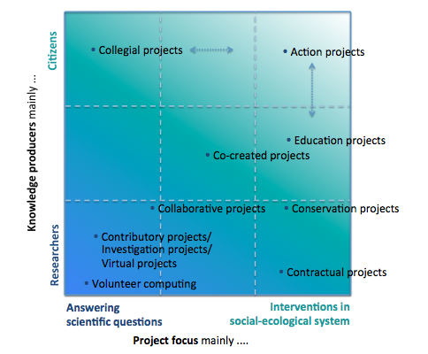
Characteristic forms
Notes:
Citizen Scienc shows different characteristic forms especially regarding the inclusion of citizens in research processes.
As you can see on this figure, in the left bottom quarter there are project forms leaded by scientific questions. In these cases it’s the researchers being mainly responsible for knowledge acquisition and citizens serve for more delimited activities such as data collection. This quarter is close to the common research process. If we move along both axes to the right, we see that the influence of the society on the research process increases – either as driver for different research questions or as knowledge producer.
In the right top quarter are projects located in which citizens generate new knowledge, which is mainly due to societal interventions.

Slide 6
Contributory or investigation projects
Focus on the investigation of specific research questions
Researchers as producers of knowledge
Citizens support data collection, analysis and dissemination
Self-improvement as desirable added value
From small local initiatives to international ones
Notes:
The contributory or investigation projects, as we have seen before located in the left bottom quarter, focus on the investigation of specific research questions, whereby researchers are the main producers of knowledge. Citizens support in data collection, analysis and dissemination.
Citizens get in most cases detailed background information and clearly outlined tasks. The projects range from small local activities to international sizes including thousands of participants.
The main goal of these projects is to generate valid and scientific results. Thorough project design, the use of scientific validation methods as well as the consideration of non-representative samples for the evaluation play an important role.
Main challenges are to keep the citizens motivated so that they stay involved and to translate knowledge content into an understandable general language.

Slide 7
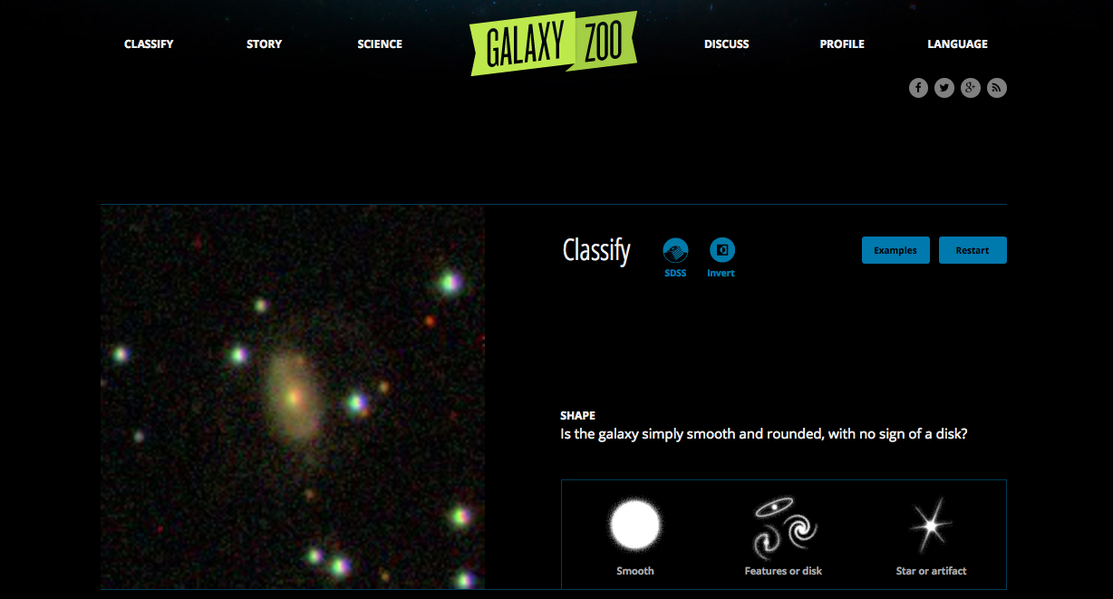
https://www.galaxyzoo.org/
Notes:
The GalaxyZoo project is one example for contributory or investigation Citizen Science projects. But, besides the simple tasks to analyse the data at the online platform the project provides access to the research data for the citizens which can be used for own research questions by interested hobby-astronomers. In this case we would talk about collegial projects, which I will explain to you next.

Slide 8
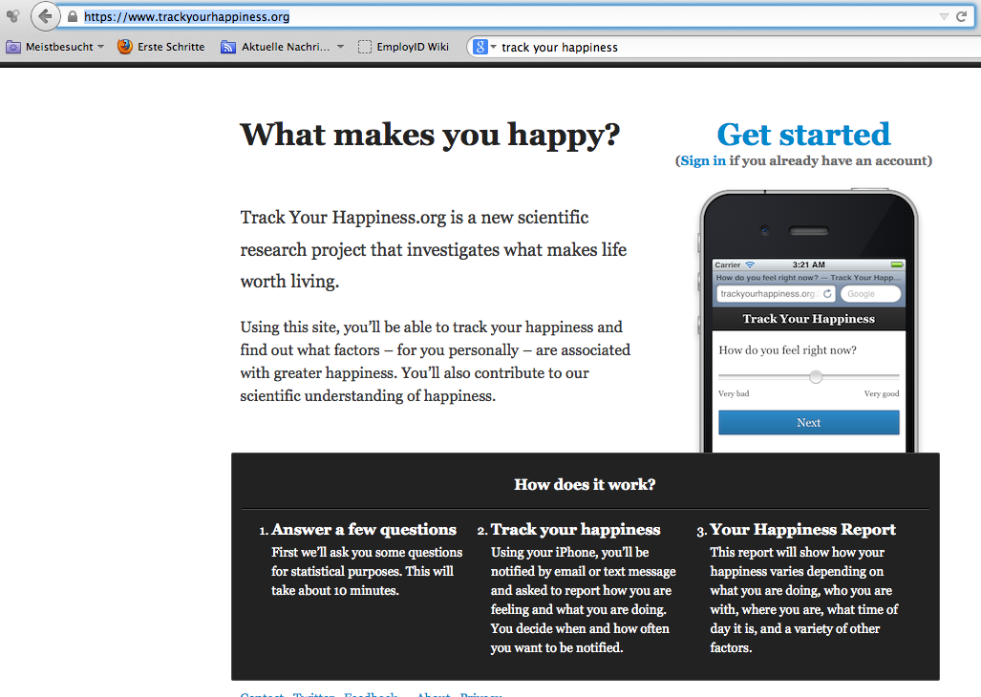
https://www.trackyourhappiness.org/
Notes:
This form of citizen science was mainly focused on natural science. However, there are also first social science questions. Like tracking ones happiness. The project documents frames of mind. Data primarily accrue to science. However, the project offers individual evaluations to the participants.

Slide 9
Collegial projects
Focuses on the investigation of one research question
Citizens as knowledge producers
Researchers are exclusively involved in the validation of the knowledge
Notes:
In collegial projects are the citizens the main knowledge producers. The collaboration with professional research institutions is given when it come to validate the new knowledge and when citizens publish their results in scientific publications.
Challenges appear to combine lay knowledge with knowledge of professional researchers and the acknowledgment of that knowledge in the institutional and academic world.

Slide 10
Bsp: Natural history associations
Field study of the London Natural History Association (http://www.lnhs.org.uk )
Notes:
The natural history associations are besides galaxyzoo great examples for collegial projects. In this association citizens interested in their environment, culture, language, history or society join together and investigate the local surrounding and its natural or cultural environment.

Slide 11
Action projects
Focus on supporting initiatives or interventions of civil society organisations – Grassroots movements
Provide fundamental principles and approaches for interventions
Citizens as initiators, researchers as collaborators
Precise research methods, extensive trainings and continuous involvement of both sides
Notes:
Action projects are mainly initiated and driven by civil society organisations or grassroots movements. Scientific research supports the concerns coming from society and from local communities and covers topics such as environment protection, living space design, or protection of public health.
Researchers are the collaborators or consultants and cooperate with citizens in defining the questions, in developing of solution proposals and in disseminating the results.
These project do not focus on the answering the scientific research question, they rather focus on societal change.
To reach their goals it need precise research methods, extensive trainings and continuous involvement of both sides.

Slide 12
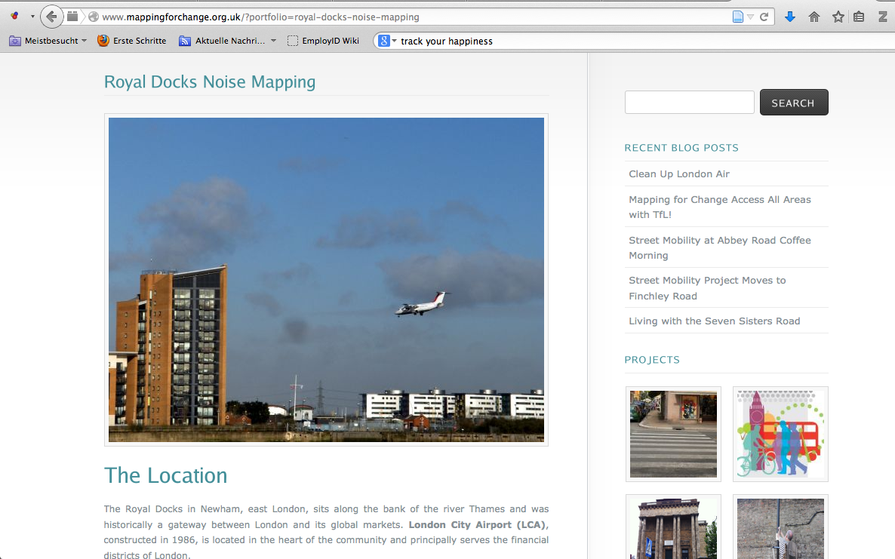
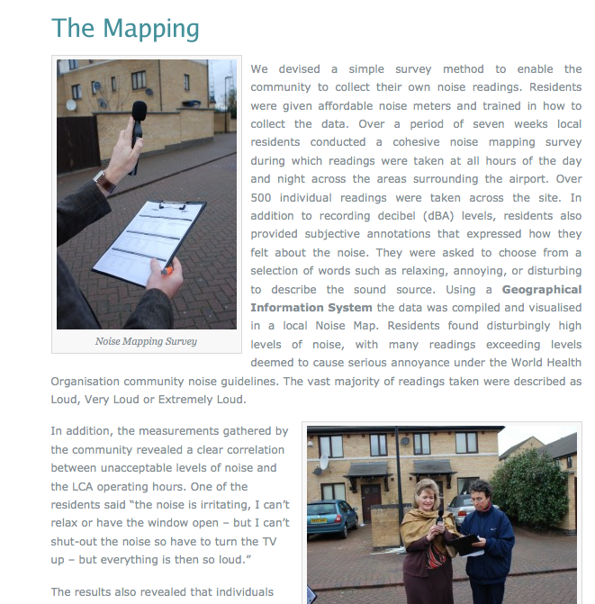
http://www.mappingforchange.org.uk/?portfolio=royal-docks-noise-mapping
Notes:
Here we a European case example from England. The “Royals Docks Noise Mapping” aims to fight the continuously increasing noise annoyance of the London City Airport, which is observed by the residents but not by the local official authorities. To make this case visible and to create a scientific basis, the neighbours invited the University College of London to support them. The scientists developed methods and protocolls to measure the noise annoyance for the residents there. After trainings the residents did daily measurements themselves.
The results of these measurements are the base of a lawsuit against the local authority, who aims to enlarge the Airport.

Slide 13
Educational projects
Focus on research communication and education
Focus on public relations activities, learning and development of scientific skills and critical thinking
Children and adolescents as participants in scientific processes
Scientists as organisers and trainers
Notes:
Educational projects focus on research communication and education. This project form offers besides informal learning possibilities through conducting scientific tasks mostly also material, which meet the formal curriculum.
The main target groups are children and adolescents. The researchers are the trainers and organisers.
These projects mostly face problems in motivation on the side of the researchers because science communication and cooperation with schools do not have priority in the scientific rubric (yet).
The main challenge is seen in the creation of eye to eye level partnerships between teachers, researchers and pupils.
A co-design with teachers is emphasised as factor of success.

Slide 14
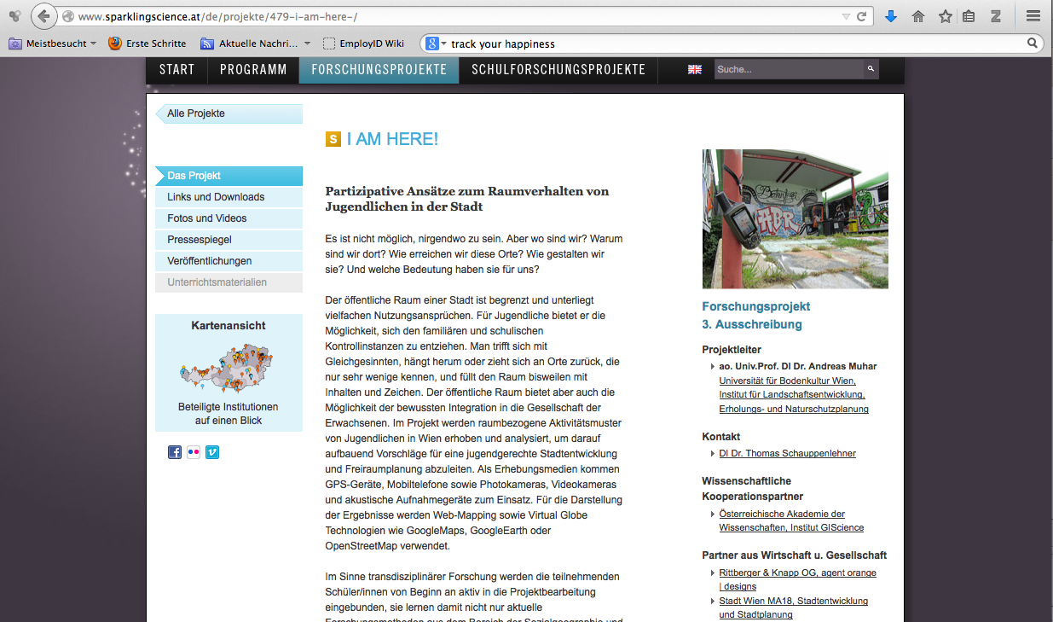
http://www.sparklingscience.at/de/projekte/479-i-am-here-/
Notes:
As an Austrian example I want to name the “I am here” project from the Sparkling Science Programme. Students analyse their habits in the public and they are constantly involved in the total scientific process.

Slide 15
Factors of success
Challenges
Project design:
Participative design processes
Adapted language
Different possibilities for integration
Technology:
Common platform
Coherent interfaces and standards, openness
Acquisition:
Cooperation with already existing organisations and networks
Data:
Quality of data
Coherent interfaces and standards, openness
Integration, Adaption, Interaction
Structures, Exchange, Synergies
Motivation:
Bi-directional communication
Appreciation and recognition of the citizens’ contribution
Intellectual property:
New IPR regulations
Recognition of lay knowledge
Content related management:
Adapted supportive material (target group, language, culture)
Motivation:
Funding and incentive systems
Notes:
This figure shows crucial factors of success and challenges for Citizen Science.
A main factor of success is the participative design process – early relationship to all project stakeholders and continuous communication.
Adaptive language to the different target groups and the development of various possibilities of involvement play an important role.
Regarding acquisition and motivation factors of success are the cooperation with already existing organisations and networks, bi-directional communication and the appreciation and recognition of the citizens’ contribution.
Further, Citizens need support. Supportive material must be adopted to the target groups, languages, culture, and so on.
Regarding technical infrastructure, a main factor of success is a common user friendly platform for citizen Science projects, to support data collection and enable continuouse communication with the citizens.
The quality of data is one of the main barriers or challenges of Citizen Science. Citizen Science Projects need quality guaranteeing measures being already considered during the project design process.
Further challenges of SC are new IPR intellectual property rights regulations and the recognition of lay knowledge. Moreover it needs new funding and incentive systems for Citizen Science.

Slide 16
EXPLORE AT
Lexicographic Croudsourcing - Development of Citizen Science
Participative design process including both sides
Projects with schools
Designed to enhance, update and relate the Dictionary of Bavarian Dialects in Austria
Notes:
ExploreAT will be a project which starts in April.
In the ExploreAT project Citizen Science will be explored in the digital humanities – in lexicography. The project implementation will be designed to enhance, update and relate the Dictionary of Bavarian Dialects in Austria.

Slide 17

Interesting literature
Shirk, J. L., Ballard, H. L., Wilderman, C. C., Phillips, T., Wiggins, A., Jordan, R., Bonney, R. (2012). Public Participation in Scientific Research : a Framework for Deliberate Design. Ecology and Society, 17(2), 29.;
Wiggins, A., & Crowston K. (2011). From Conservation to Crowdsourcing: A Typology of Citizen Science. Proceedings of the Forty-fourth Hawai'i International Conference on System Science (HICSS-44).
Catlin-Groves, C. L. (2012): The Citizen Science Landscape: FromVolunteers to Citizen Sensors and Beyond. International Journal of Zoology, Volume 2012, Article ID 349630, 14 pages, doi:10.1155/2012/349630, Hindawi Publishing Corporation
Finke, P. (2014): Citizen Science: Das unterschätze Wissen der Laien. oekom verlag München. ISBN-13: 978-3-86581-466-1

Slide 18
Centre for Social Innovation
Social innovation in Austria for Europe
The Centre for Social Innovation (ZSI) researches and supports innovation processes including their social dimensions. Since 1990, the Centre has carried out more than 400 research and stimulus projects. This means that social innovations are right up there with economically relevant technical innovations and are considered equally significant by the public, politics and research.

