Slide 1
Portuguese Sign Language (LGP) and the Portuguese Deaf Community: Language, Culture, History
Maria José Freire
Phd student from FCSH, Universidade Nova, Lisboa, Portugal
Presentation at KU Leuven – Antwerp – 30 October 2014

Slide 2
Official recognition of LGP
- Língua Gestual Portuguesa
Portuguese Deaf Community founded a commission to fight for the official recognition of LGP in November 15th, 1995. This is now celebrated every year as the National Day of LGP.
Deaf associations, parents, interpreters, teachers, families and friends were represented there.
They held meetings with government, ministeries, political parties, parliament representatives, and managed to include LGP recognition within the Constitution which was beeing revised.

Slide 3
Deaf community attended during debates at the Parliament for the revision of Portuguese Constitution with volunteer sign language intepreters all the time.
Finaly it was approved in July 1997, and published in Diário da República in september,22nd, Law 1/97:
    “To protect and to value portuguese sign language as cultural expression and a tool to access education and equal opportunities”

Slide 4
Other achievements followed
Despacho 7528/98 – L3/2008 – established bilingual education for deaf children
Subtitles in portuguese television programmes
Sign language interpretation of several news information programmes and entertainment
Academic training for teachers of LGP and SLInterpreters

Slide 5
LGP history
LGP, as other sign languages all over the world, is not a recent language.
It has been developing and growing according to the needs of the Deaf community.
Deaf people have been using it for centuries, although sometimes it is hard to find proof.

Slide 6

One proof of LGP in XVth century
This book tells the story of the presecution of jews in Lisbon by the end of the 15th and begining of the 16th century.
While reading this book, which accounts for a true narrative, I was surprised to find that there was a deaf person (Farid) in this narrative and that the narrator and him were friends from birth.
Since their childhood they used a sign language to communicate. Throughout the book we can find lots of references to their communication using signs.

Slide 7
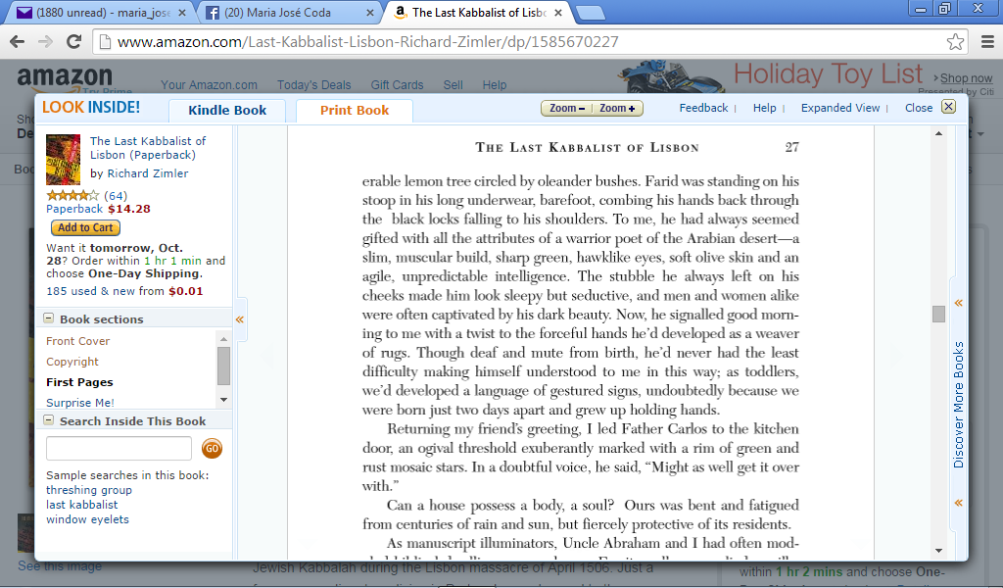
One excerpt from the book

Slide 8
First school for the Deaf in Portugal
In 1823 the first school for the Deaf (and also for the blind) was founded by our king D. João VI because his daughter D. Isabel Maria was concerned about these children.
Pär Aron Borg, a swedish teacher was invited to organize and direct this school.
He introduced a manual alphabet and used teaching methodologies that included signs. That is why our manual alphabet today and some signs are similar to the swedish ones.

Slide 9
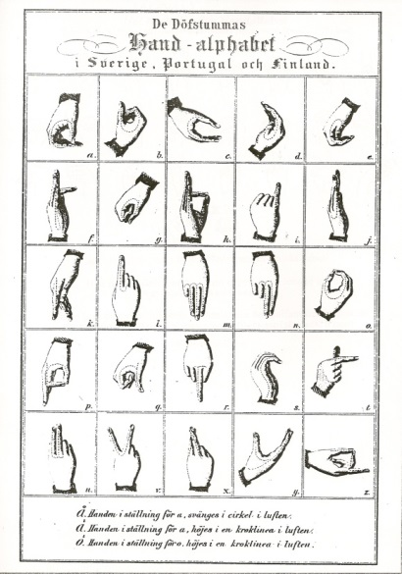
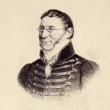
Pär Aron Borg and his manual alphabet

Slide 10
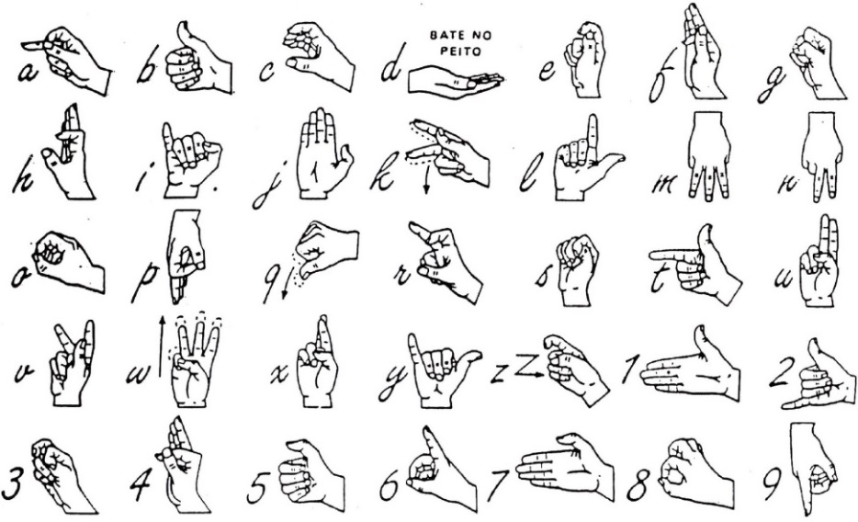
Portuguese manual alphabet

Slide 11
Training of SLInterpreters and teachers of LGP
Late 1980’s and early 1990’s
  Professional training of interpreters and SL teachers
1997/1998 SL interpreter training
  Academic training (5 year programme for interpreters) – After Bologna only 3 year
2004/2005 SL teacher training
  Academic training (3 year programme)

Slide 12
Language and linguistics
First linguistic study about Portuguese Sign Language, by Isabel Prata in 1980:
  “Mãos que falam” includes a brief description of linguistic aspects of LGP and photos of about 70 signs from the LGP.
First LGP dictionary was published in 1991:
  “Gestuário da LGP” containing 500 signs
A new study about LGP grammar was published in 1994, by a linguist and two teachers of the deaf:
  “Para Uma Gramática da Língua Gestual Portuguesa”.

Slide 13
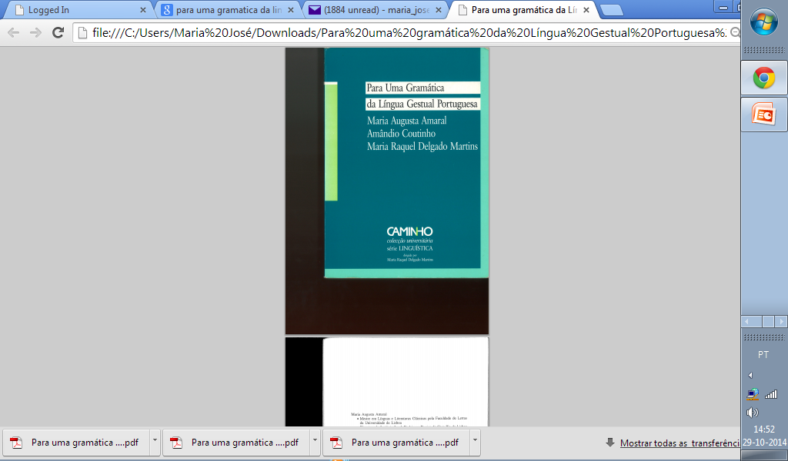
Sign language grammar
This study establishes the first findings about portuguese sign language linguistic principles.
As the authors do mention it is incomplete and needs more investigation and reflexion.
Several papers have been published since, studying different grammatical aspects and linguistic features of LGP.

Slide 14
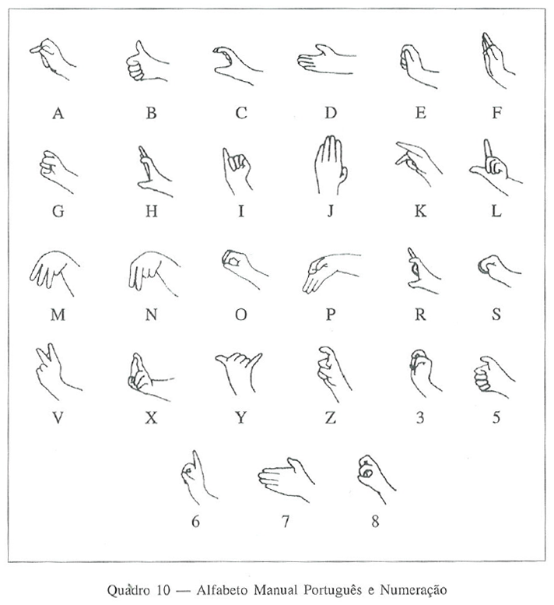
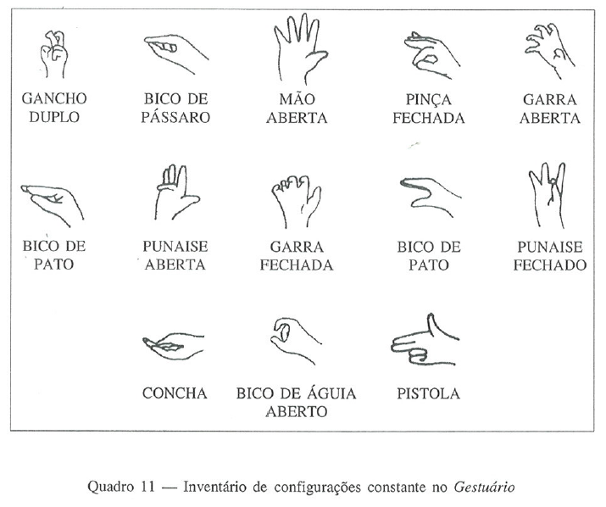
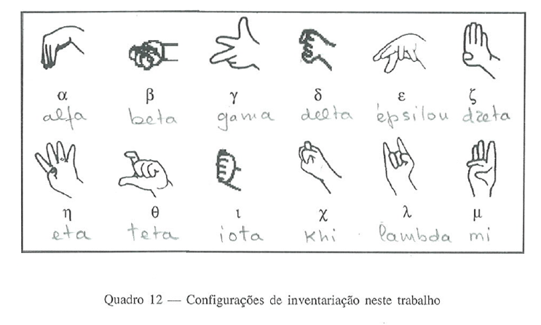
Hand Configurations from Para uma Gramática da LGP (1994)

Slide 15
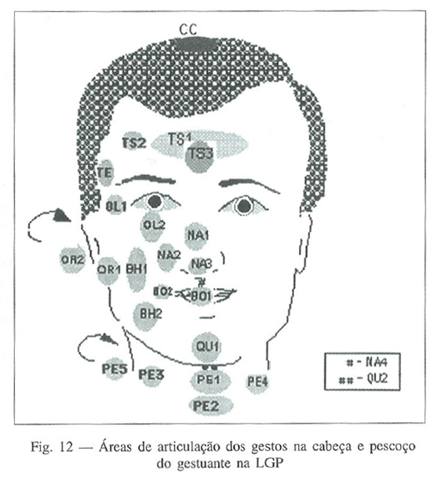
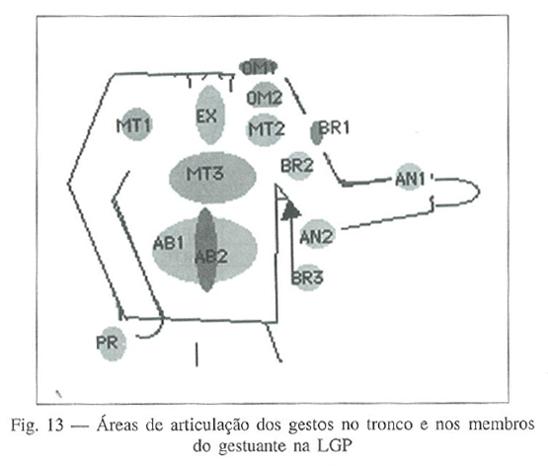
Localization – signs attached to the body
From Para uma Gramática da Língua Gestual Portuguesa (1994)

Slide 16
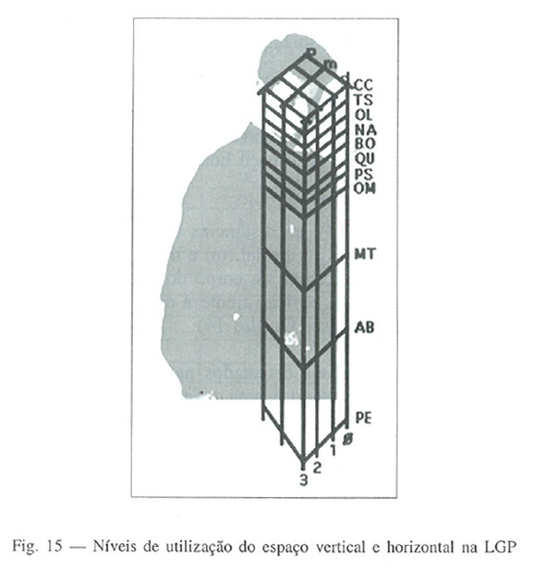
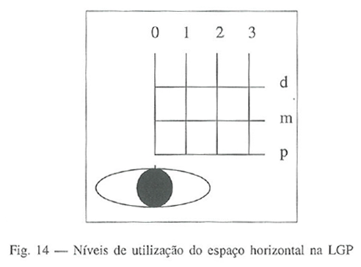
Localization – signs away from the body

Slide 17
Other phonological components
Orientation (Soares & Bettencourt)
  Neutral (palm towards body) (Ex: PEACH)
  Pronated (palm down/back) (Ex: FORM)
  Supinated (palm up/front) (Ex: CULTURE)
  Inverted (palm to the side/out) (Ex: PUT.AWAY.TO.THE.SIDE)
Movement
Non manual aspects/expressions

Slide 18
New signs – My Phd investigation
Political, social and economic changes give ground to new needs of communication.
Also in the Portuguese Deaf community
  1974, April 25th – Major political change in Portugal – begining of democracy
  1981 – International Year of People with Disabilities
  1985 – Portugal joined the EEC, now EU – European Union

Slide 19
Contexts of lexical productivity
Political – new concepts expanded from old ones
    REPUBLIC – CONSTITUTION; PARLIAMENT; DEMOCRATIC.ELECTION….
Social – equal opportunities
    EQUAL.OPORTUNITIES; CITIZENSHIP; HUMAN.RIGHTS
Education – further studies
    BILINGUALISM; UNIVERSITY; INVESTIGATION
New technologies
    COMPUTER; MOBILE.PHONE; FACEBOOK….

Slide 20
Research methology
Corpus
  LGP videos: Deaf associations; Deaf news; individuals
Data collection
  Visualization; notation; register (files)
Analysis
  Validation of new signs (group of native speakers)
  Lexicology and lexicography - productive processes
  Neology criteria
Final results
  Validated files

Slide 21
Thank you ☺
Two DVD:
  Gestuário Digital – Dictionairy of LGP (Língua Gestual Portuguesa)
  1997- 2007: 10 Years of LGP recognition - Deaf community views (english subtitles)
maria_josea@yahoo.com

