Slide 1
WG3: Innovative e-dictionaries
Simon Krek
„Jožef Stefan“ Institute, Ljubljana, Slovenia
Carole Tiberius
Institute of Dutch Lexicology, Leiden, the Netherlands

Slide 2
Programme
11:15-11:35 INFO & PRACTICALITIES
11:35-12:15 WORK PLAN & TIME-TABLE
12:15-12:40 TASKS FOR BOLZANO
12:40-12:50 THE LORENTZ CENTER
12:50-13:00 AOB AND CLOSING

Slide 3
PRACTICALITIES
short introduction and presentation of the chair and vice-chair
overview of countries (and dictionaries) represented in WG3
topics - what do we mean by an innovative e-dictionary in WG3?
sharing tasks
e-publications

Slide 4
WG3 chair – Simon Krek
employment
    1994-2004 DZS Publishing House, dictionary editor
    2005-2007 Faculty of Arts, Uni-Ljubljana
    2008-2013 Amebis, d.o.o., Kamnik
    2007- Jožef Stefan Institute
    2013- Faculty of Social Sciences, Uni-Ljubljana
projects
    1995-2006 The Oxford®-DZS Comprehensive English- Slovenian Dictionary, editor-in-chief
    1996-2000 FIDA Corpus, coordinator
    2005-2006 FidaPLUS Corpus, coordinator
    2008-2013 Communication in Slovene, coordinatior

Slide 5
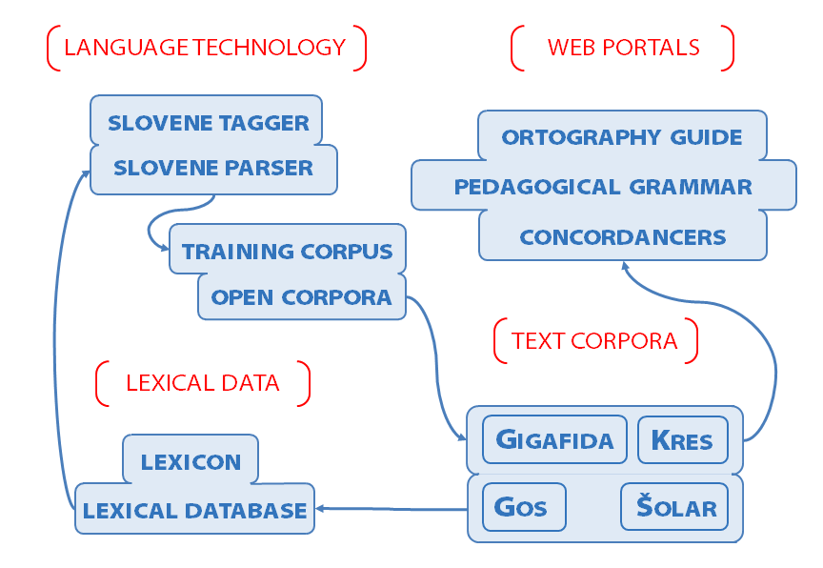
Communication in Slovene project (2008- 2013)

Slide 6
WG3 vice-chair – Carole Tiberius
1992 degree in translation (Russian-French), Antwerp, BE
1995 MA in computational linguistics,
Nijmegen University, NL
2001 PhD in Multilingual Lexical Knowledge Representation,
Brighton University, UK
2001-2006 Research fellow Surrey Morphology Group, Surrey University, UK
2006- Computational linguist (ANW, Taalportaal)
Instituut voor Nederlandse Lexicologie (INL)

Slide 7
Working group 3
WG3 Innovative e-dictionaries: This WG will coordinate the development of born-digital dictionaries, focusing on the latest developments in e-lexicography and the interface between lexicography and computational linguistics.

Slide 8
General background
(a) ...at present scholarly dictionaries ... are often not easy to find...
(b) ...scholarly dictionary projects make their products available on the Internet... common standards and solutions
(c) In the past few years, innovative electronic dictionaries have been created that no longer resemble traditional paper dictionaries but try to fully exploit the new possibilities of the digital medium.
Notes:
COMMENT: Where does the c) come from, same for b) and d) later on????

Slide 9
General background (c) ctd.
Though serious attempts have already been made at embedding electronic lexicography into a theoretical framework, a new research paradigm and common standards for electronic lexicography are still lacking.
And so are common standards and cooperation for the interlinking of the content of digitized dictionaries and innovative e-dictionaries.

Slide 10
Scientific focus
(a) turning paper dictionaries into a digital format
(b) mapping current and possible future trends for the creation of born-digital dictionaries, focusing on the latest developments in e-lexicography and the interface between lexicography and computational linguistics
(c) obtaining and overview ... accessibility of authoritative dictionary information ... can be improved ...

Slide 11
Scientific focus ctd
(d) exploring the possibilities of extensive linking of dictionary content from different European languages
(e) developing shared editorial standards and discussing new methodologies to describe the common European heritage of much of the vocabularies of the languages of Europe

Slide 12
Other WGs
In this WG, requirements from WG1 dealing with linking information between dictionaries and with the user interface will be taken into account.
Interaction will also take place with WG4 to be able to take into account the new insights into the lexicographical description of the vocabularies of the different European languages.

Slide 13
WORK PLAN & TIME-TABLE
topics (from the original proposal)
meetings (6)
  results
  outputs
training school (year 3)

Slide 14
Topics – WG3
description of the workflow for corpus-based lexicography
overview of existing software needed in this workflow
Dictionary Writing Systems (and Corpus Query Systems)
Analysis of the possible impact of automatic acquisition of lexical data (distributional thesauri etc.)
Analysis of the interface between dictionaries and computational lexica (cf. wordnets) and syntactically and semantically annotated corpora (FrameNet, Semcor, Senseval)
Investigation of possible use of dictionary content for computational linguistic applications

Slide 15
July 2014
Workflow of corpus-based lexicography; Software to support lexicographical workflow (backup, version control etc.)
responsibility:
  Carole Tiberius
result:
  better understanding of the workflow (including an overview of software that is necessary for a smooth workflow) which results in better planning of future projects
output: deliverable

Slide 16
January 2015
Software to support lexicographical workflow: DWS and CQS
responsibility:
  Simon Krek
result:
  description of DWSs and in particular the newly developed (web) applications for querying corpora
output: deliverable, report in eLex2015?

Slide 17
July 2015
Automatic acquisition of lexical data and its impact (what works, what doesn’t work – example sentences, collocations, neologisms, definitions, word senses)
responsibility:
  Carole Tiberius
result:
  exploring the possibility of automation of particular tasks within corpus-based lexicography as support to lexicographers / lexicographical workflow

Slide 18
January 2016
Between Corpora and Dictionaries – analysis of the interface between dictionaries and computational lexica and corpora
responsibility:
  Simon Krek
result:
  exploring the possibiltiy of collecting lexically and semantically organized data in a completely automated process where the data could be used for immediate visualization for human users interested in lexical behaviour of words

Slide 19
July 2016
The use of lexicographical data in computational linguistics – investigation of possible use of dictionary content for computational linguistic applications
responsibility: ?
Result:
  better understanding of the need of computational linguistic community for lexicographically organized data and vice versa

Slide 20
Other topics
presentation, layout, design issues of e-dictionaries as well as access routes?
which other topics do we miss?
is the proposed order of the topics OK?

