Slide 1
Working Group 1
Vienna 14 April 2014

Slide 2
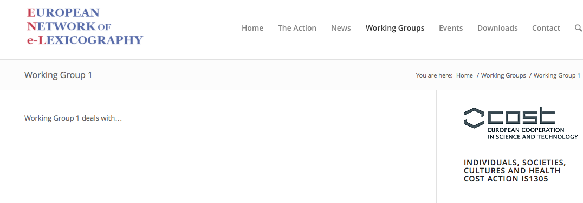

Slide 3
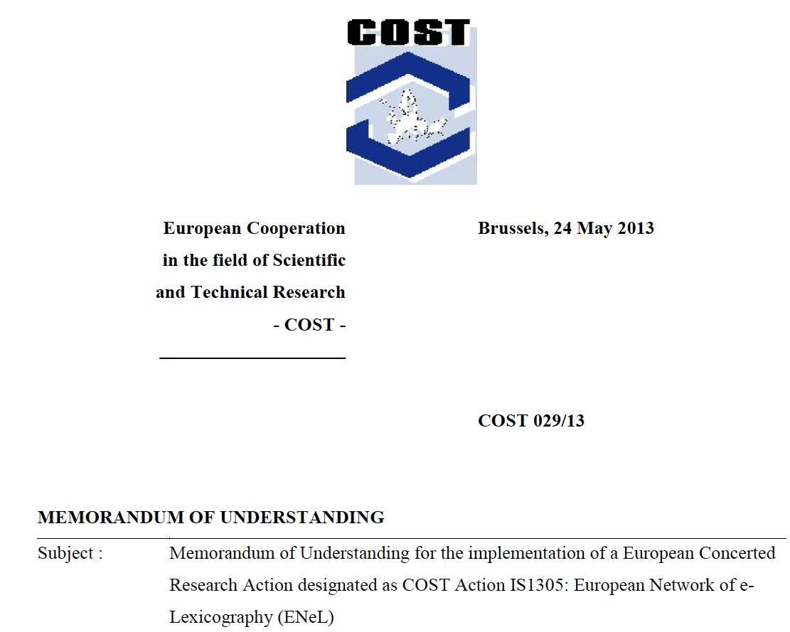

Slide 4
make lexical knowledge of the languages of
Europe available in a European dictionary portal
(b) enable cooperation and the exchange of
resources, technologies and experience
(c) discuss standards for innovative e-dictionaries
(d) establish new ways of representing the
common heritage of the languages of Europe

Slide 5
Bridge the gap between the general public and
scholarly dictionaries by improving access to these
dictionaries and making them more widely known.
The proposed Action aims to establish a European
network of lexicographers in order to deal with the
above issues in a structured way.

Slide 6
Common standards and cooperation for the
interlinking of the content of digitized dictionaries
and innovative e-dictionaries are still lacking.
There is a clear need for a common approach to
e-lexicography that forms the basis for a new type
of lexicography that fully embraces the pan-European
nature of much of the vocabularies of the languages
spoken in Europe

Slide 7
Create a European dictionary portal with
information on and access to the academic
dictionaries of Europe the Action aims to make
authoritative dictionary information visible for a
much wider audience and easily accessible to other
lexicographers, researchers from other disciplines,
writers and translators, to visually impaired people
and to the general public

Slide 8
The Action will
make lexical knowledge of small and large
languages available in a European dictionary
portal; this portal will serve as the central reference
point for all dictionary users who look for
reliable, authoritative dictionary information on the
languages of Europe and their histories on the
Internet.

Slide 9
The Action will
d) establish new ways of representing the common
heritage of European languages by developing
shared editorial practices and by interconnecting
already existing information

Slide 10
The portal will list and give information on
scholarly dictionaries of the languages of Europe
(it will allow sorting by various parameters, e.g.
dictionary type, language covered, electronic vs.
retro-digitized)
and provide access to these dictionaries
New European dictionary portal with
information on and access to the scholarly
dictionaries

Slide 11
WG1 will cooperate with WG2 and WG3, which are
concerned with developing common standards in
the field of e-lexicography
WG4 will further consider how the extensive
interlinking of information from many different
dictionaries (implemented by WG2 and WG3
together with WG1) allows lexicographers to get
away from a single language approach to
lexicography and will investigate how these vast
amounts of language data can generate new lines
of research in the field of digital humanities

Slide 12
The Action will produce a roadmap to possible ways
for the extensive linking and interconnection of the
data contained in European dictionaries in the
European dictionary portal that will generate new
lines of research in the field of digital humanities

Slide 13
The Action will produce a roadmap to possible ways
for the extensive linking and interconnection of the
data contained in European dictionaries in the
European dictionary portal that will generate new
lines of research in the field of digital humanities
The Action focuses on the following areas:
[…] exploring the possibilities of extensive linking
of dictionary content from different European
languages

Slide 14
The European dictionary portal will make lexical
information on the languages of Europe accessible
to the general public, to lexicographers and to
other scientists. The results obtained in the WGs
will also feed into the presentation of information
in the dictionary portal
The European dictionary portal will link the Action
to the general public and non-expert dictionary
users. It will provide authoritative lexical
information on the languages of Europe

Slide 15
Providing of Information
Brief descriptions of and links to on-going
dictionary projects (keep up-to-date).
Refer to events in the field of e-lexicography.
Refer to publications in e-lexicography.
Provide blogs and discussion lists.
(Facebook)

Slide 16
Discovery
Simple link farm, with links to available online
dictionaries. Links may be grouped according to
one or more properties.
Search facility to find dictionaries according to properties. Search is only useful if there are
sufficient (e.g. > 100) dictionaries to choose from.
A contact form, allowing others to add entries to
the link - or reference database.
A list of references to available printed dictionaries.

Slide 17
Search Dictionary Content; Human Interface
Search in single dictionary.
Results are presented directly to the user within
the portal. No redirection to the particular online
dictionary.
The presentation within the portal may be different
from the online dictionary.
Some features might be lost.

Slide 18
Search Dictionary Content; Human Interface
Federated search in multiple dictionaries.
For instance by choosing a certain language
which automatically selects all corresponding
dictionaries.
Presentation and features may differ from the
original online dictionaries.
Search parameters may need to be restricted
to those that all dictionaries have in common.

Slide 19
Search Dictionary Content; Human Interface
Search a dictionary in the source language.
The lemma will contain a direction to a lemma
of a dictionary in the target language, also at
the lemma level. This feature assumes that the
monolingual dictionaries are linked at the level
of the lemma.
Search at the level of separate meanings.
This features requires the monolingual
dictionaries to be linked at the level of meanings.

Slide 20
Search Dictionary Content; Machine Interface
Access to lemma’s or meanings according to
search parameters provided.
Frequency information for word forms.
The website sends the word form and other
Information to the portal service and retrieves
relative frequency information. This might be
useful to e.g. select the words in a document
that require elucidation.

Slide 21
Search Dictionary Content; Machine Interface
Disambiguation tools as a web service.
The website sends the word form in its context.
The portal service returns dictionary content
corresponding to the most likely meaning of
the word.

Slide 22
Cross-dictionary Content Creation
Cross-link lemma’s, meanings, etymological
information etc. from several dictionaries.
Cross-link descriptive dictionaries and
etymological dictionaries across languages.

Slide 23
Dictionary Content Creation
Corpus analysis tools. The portal may provide a facility to store large corpora of all European languages and make them accessible by means of advanced tools for querying and analysis.
Neologisms. A central service to analyze and
compare corpora in order to detect possible
neologisms.

