Slide 1
ENeL:
European Network of e-Lexicography
COST Action IS1305
Notes:
On October 11th 2013, the kick-off meeting of a European project called European Network of e-Lexicography (abbreviated as ENeL) took place in Brussels. This was the result from an idea that was ventilated one and a half year earlier, in March 2012 in Berlin, at a European workshop on future standards in lexicography. The participants of this workshop confirmed the imperative to coordinate and harmonise research in the field of (electronic) lexicography across Europe, more precisely to share expertise relating to standards in (electronic) lexicography, discuss new methodologies in lexicography that fully exploit the possibilities of the digital medium and reflect the pan-European nature of the languages of Europe and to reach a wider audience.

Slide 2
What is COST?
COST (European Cooperation in Science and Technology) is one of the longest-running European frameworks supporting cooperation among scientists and researchers across Europe.
http://www.cost.eu/
Notes:
A proposal was written, partners were found and eventually, the action was approved of by COST (European Cooperation in Science and Technology), which is a European framework supporting cooperation among scientists and researchers across Europe. This means that for the next four years there is a certain amount of European money available for meetings, workshops and conferences regarding the European Network of e-Lexicography.

Slide 3
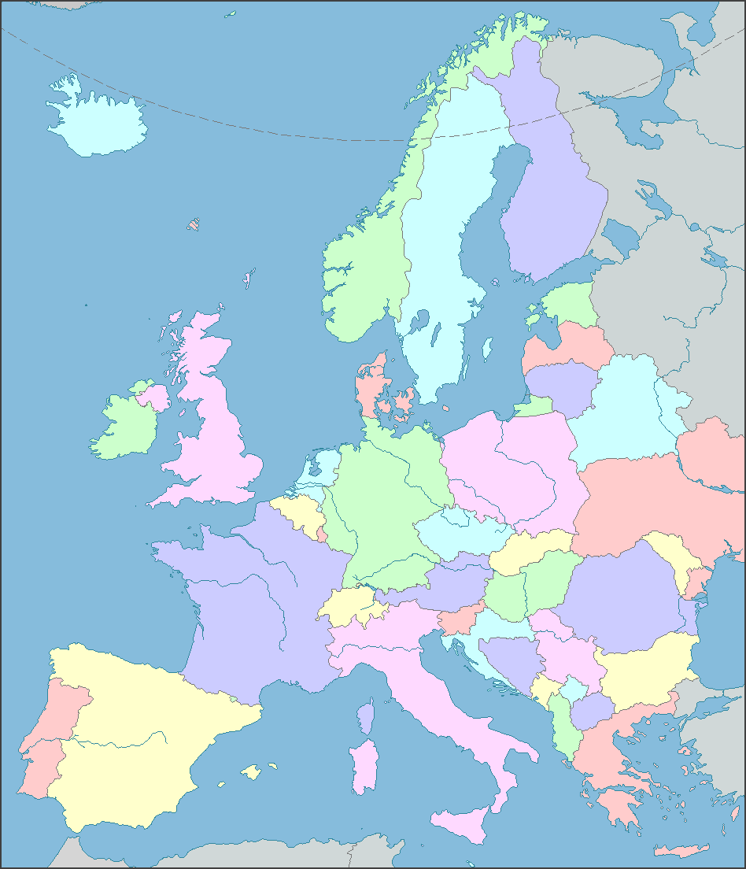
ENeL: European Network of e-Lexicography
ENeL Participants
Prospective
Participants
Commercial
Participants
Notes:
The general background for setting up the network was that computers and the availability of the World Wide Web have significally changed the conditions for the production and reception of dictionaries. The Internet offers entirely new possibilities for the presentation of dictionary information, for example, the integration of sounds, maps or video, and various novel ways of interacting with dictionary users. For editors of scholarly dictionaries the new medium is not only a source of inspiration, it also generates new and serious challenges that demand cooperation and standardization on various levels.

Slide 4
General background
Prevalence of user-generated dictionaries/growing gap between scholarly dictionaries and the general public
Lack of common standards and solutions for retro-digitized dictionaries
Lack of a common research paradigm, common standards and solutions for e-lexicography
In dictionaries languages are treated as isolated entities
Notes:
Through the Internet scholarly dictionaries can potentially reach a very large audience. However, at present scholarly dictionaries providing reliable information are often not easy to find and hard to decode for a non-academic audience; ‘traditional’ dictionary users tend to use easily accessible non-academic, user-generated dictionaries. In order to let a larger audience benefit from high quality dictionary content, we should bridge the gap between the general public and scholarly dictionaries by improving acces to these dictionaries and making them more widely known.
Most scholarly dictionary projects make their products available on the Internet or are planning to go online. All of them find themselves confronted with similar problems relating to technologies for producing lexicographical content, presentation of content, interaction with dictionary users, etc. Most dictionaries take different approaches to and find different solutions for these problems. So far European cooperation in these fields has been restricted to bilateral collaborations. There is a clear need for a broader and more systematic exchange of expertise and for the establishment of common standards and solutions.
In the past few years, innovative electronic dictionaries have been created that no longer resemble traditional paper dictionaries but try to fully exploit the new possibilities of the digital medium. Though serious attempts have already been made at embedding electronic lexicography into a theoretical framework, a new research paradigm and common standards for electronic lexicography are still lacking. And so are common standards and cooperation for the interlinking of content of digitized dictionaries and innovative e-dictionaries.
The digital medium has the potential for a new type of lexicography that no longer views languages as isolated entities. Language migration has always been part of language history, yet this is often not properly reflected in dictionaries. Many dictionaries have their origins in the 19th century, where a national perspective on language prevailed. Consequently, the information in the dictionaries is mostly presented from the point of view of a single language, not sufficiently taking into account similar or related developments in other European languages. This view of languages often also dominates modern dictionaries. There is a clear need for a common approach to e-lexicography that forms the basis for a new type of lexicography that fully embraces the pan-European nature of much of the vocabularies of languages spoken in Europe.

Slide 5
Aims
Make authoritative dictionary information on the languages of Europe accessible in a European dictionary portal
Further the exchange of technologies and expertise and provide support to other dictionary makers
Develop shared editorial practices to represent the pan-European nature of the languages of Europe
Coordinate and increase research in the field of (electronic) lexicography across Europe
Notes:
The aim of the European Network of e-Lexicography is to increase, co-ordinate and harmonise European research in the field of e-lexicography and to make authoritative information on the languages of Europe easily accessible.
The network will
Make lexical knowledge of small and large languages available in a European dictionary portal. This portal will serve as the central reference point for all dictionary users who look for reliable, authorative dictionary information on the languages of Europe and their histories on the Internet.
Enable cooperation and the exchange of resources, technologies and experience in e-lexicography and provide support for dictionaries which are not yet online.
Discuss and aim at establishing standards for innovative e-dictionaries that fully exploit the possibilities of the digital medium.
Establish new ways of representing the common heritage of European languages by developing shared editorial practices and by interconnecting already existing information.

Slide 6
Working Groups
WG 1: Integrated interface to European dictionary content
WG 2: Retro-digitized dictionaries
WG 3: Innovative e-dictionaries
WG 4: Lexicography and lexicology from a pan-European perspective
Notes:
Four working groups will be the main vehicles of delivering the scientific work plan. Each working group will comprise lexicographers, computational linguists and preferably also software engineers from different countries and will include both more experienced researchers and young researchers. There will be a working group Chair and a working group Vice-Chair. All researchers affiliated to an institution in a COST country can join the network. There is also room for researchers from countries neighbouring a COST country and for researchers from Argentina, New Zealand and South Africa. For these last two categories there is a special procedure which is explained on the COST website (www.cost.eu).

Slide 7
WG 1 Integrated interface to European dictionary content
Set up a European dictionary portal, which will give information on scholarly dictionaries of the languages of Europe and provide access to these dictionaries through the portal website
Investigate the possibilities of interlinking the contents of European dictionaries
Investigate user requirements with respect to the presentation of dictionary content
Investigate the possible involvement of users in the creation of dictionary content
Notes:
The first working group will investigate how authoratative dictionary information on the languages of Europe can be made accessible to both the general and academic public. It will
Set up a European dictionary portal, which will give information on scholarly dictionaries of the languages of Europe and provide access to these dictionaries.
Investigate the possibilities of interlinking the contents of European dictionaries.
Investigate user requirements with respect to the presentation of dictionary content.
Investigate the possible involvement of users in the creation of dictionary content.

Slide 8
WG 2 Retro-digitized dictionaries
Standards for the encoding of information and the description of relevant information categories for print dictionaries
Software for the conversion of physical lay-out information to logical information
Investigation of relevant information categories to be added to the dictionary in order to make the dictionary content more readily accessible and interoperable
Development of a work plan for digitisation, including parameters necessary for estimating costs
Investigation of the possible use of dictionary content for computational linguistic applications
Organising a training school on standard tools and methods for retro-digitising dictionaries in 2015.
Notes:
Working group 2 is about retro-digitized dictionaries. It intends to set up guidelines and standards for turning paper dictionaries into digital format.
Work will be carried out on
Standards for encoding of information and the description of relevant information categories for print dictionaries.
Software for the conversion of physical lay-out information to logical information.
The investigation of relevant information categories to be added to the dictionary in order to make the dictionary content more readily accessible and interoperable.
The development of a workplan for digitisation, including parameters necessary for estimating costs.
The investigation of the possible use of dictionary content for computational linguistic applications.
Organising a training school on standard tools and methods for retro-digitising dictionaries in 2015.

Slide 9
WG 3: Innovative e-dictionaries
Description of the workflow for corpus-based lexicography
Overview of existing software needed to set up this workflow
Dictionary writing systems
Analysis of the possible impact of automatic acquisition of lexical data (distributional thesauri etc.)
Analysis of the interface between dictionary and computational lexica (cf. wordnets) and syntactically and semantically annotated corpora (FrameNet, SemCor, Senseval)
Investigation of possible use of dictionary content for computational linguistic applications
Organising a training school on innovative approaches in e-lexicography in 2016.
Notes:
The third working group will focus on the development of digitally born dictionaries, focusing on the latest developments in e-lexicography and the interface between lexicography and computational linguistics.
Work will be carried out on
The description of the workflow for corpus-based lexicography.
Providing an overview of existing software needed to set up this workflow
Dictionary writing systems
The analysis of the possible impact of automatic acquisition of lexical data.
The analysis of the interface between dictionary and computational lexica (cf. wordnets) and syntactically and semantically annotated corpora (cf. FrameNet, SemCor, Senseval).
The investigation of the possible use of dictionary content for computational linguistic applications.
Organising a training school on innovative approaches in e-lexicography in 2016.

Slide 10
WG 4 Lexicography and lexicology from a pan-European perspective
Develop ways in which already existing information from single language dictionaries can be displayed and interlinked to represent more adequately their common European heritage
Develop editorial guidelines for the integration of European information into more traditional and into innovative e-dictionaries
Find new applications for the very large amount of interconnected dictionary information from the European dictionary portal in the field of digital humanities
Organise a training school in lexicography and lexicology from a pan-European perspective in 2017
Notes:
Working group 4 will investigate how the pan-European nature of the vocabularies of the languages of Europe can be represented in single-language dictionaries and within the European dictionary portal. This is particularly relevant to studying the multiple dimensions of borrowing, i.e. the migration and re-migration of words and meanings across the languages of Europe.
This working group will
Develop ways in which already existing information from single language dictionaries can be displayed and interlinked to represent more adequately their common European heritage.
Develop editorial guidlines for the integration of European information into more traditional and into innovative dictionaries.
Find new applications for the very large amount of interconnected dictionary information from the European dictionary portal in the field of digital humanities.
Organise a training school in lexicography and lexicology from a pan-European perspective in 2017.
The training schools will be organised in cooperation with a special training school manager.
There are also possibilities for so-called short time scientific missions, in which researchers will be enabled to visit established dictionary projects and centres of excellence. A special manager will be appointed to organise these missions. These visits will range from discussions and demonstrations to possible longer involvement in the activities of the centres visited, in accordance with the needs of the researchers. These stays are especially meant for young researchers, but also experienced researchers can make use of them.

Slide 11
Organisation & Management
Management Committee
Chair (Martin Everaert, INL)
Vice-Chair (Iztok Kosem, Trojina)
two representatives per COST country
Steering Group
Chair and Vice-Chair of MC, Chairs and Vice-Chairs of WGs, Short Term Scientific Mission-manager, Training School manager, Early Stage Researcher and Female Researcher-manager
Working groups (WG 1, WG 2, WG 3, WG 4)
WG Chair and WG Vice-Chair
Training school manager
ESR and Female Researcher manager
STSM manager
Notes:
The network will be driven by a Management Committee, comprising an elected Chair and Vice-Chair and up to two representatives from each COST country. The MC meets every six months and is responsible for co-ordinating the activities of the working groups, budget planning and the allocation of funds, organising training schools and conferences. It will monitor progress in relation to the scientific focus and workplan in relation to the achievement of milestones.
The Steering Group consists of the Chair and Vice-Chair of the MC, the Chair and Vice-Chair of the four working groups and the three specialised managers for the training schools, the short term scientific missions (STSM) and the young (ESR) and/or female researchers. The steering group will meet every three months, either face-to-face, or by video-conference. It is responsible for preparing annual reports on the work of the network, overseeing the development and maintenance of the network website, communicating with the COST office and monitoring the COST procedures.
Members of the network meet at least every six months. Meetings of the Management Committee are preferable combined with meetings of the working groups. At the end of these meetings there is always a plenary session to inform all working groups on the progress that has been made. Training schools will either precede or follow these meetings to reduce travel costs.

Slide 12
Meetings (2014)
16-01-2014 Leiden
- Meeting MC and WGs
19/20-07-2014 Bolzano (EURALEX)
- Meeting MC, SG and WGs
Notes:
The next meeting of the Management Committee will be in Leiden on the 16th of January 2014. Here the Working Group Chairs and Vice-Chairs will be appointed by the Committee, as well as the three Managers of STSM, ESR/female researchers and Training Schools. After this, the Working Groups will get started, preferable at the same occasion. The next meeting of the Management Committee (MC), the Steering Group (SG) and the Working Groups (WGs) will be at the EURALEX congress in Bolzano in July 2014.

Slide 13
ENeL: European Network of e-Lexicography
ENeL Participants
Prospective
Participants
Commercial
Participants
Notes:
At the moment the network comprises of representatives from Austria, Belgium, Denmark, Estonia, Finland, France, Germany, Hungary, Iceland, Italy, Latvia, Norway, The Netherlands, Poland, Portugal, Switzerland, Slovakia, Slovenia, Spain and the UK. Their are contacts with representatives from the Czech Republic, Georgia, Greece, Ireland, Israël, Morocco, New Zealand, Russia, South Africa and Sweden to join the network. More participants are still welcome.

Slide 14
To join COST Action IS1305
IF your country is not yet registered for this Action, you need to contact your COST National Coordinator and ask for an application form to join the Action
IF your country is already registered for this Action, you need to contact your COST MC representative to discuss your involvement in the Action and its working groups.
OR contact the Chair of the Action at cost@inl.nl
Notes:
To join the European Network of e-Lexicography (COST Action IS1305) you have to follow the European procedure.
- If you are an inhabitant of one of the countries that already is a member of the network and you want to join too, please contact your national MC member.
- If you are an inhabitant of a country that is not yet a member, you have to contact your COST National Coordinator, who will inform you officially on how to join (names of the coordinators are to be found on www.cost.eu).
If your country is not in the COST agreement, there are special rules, which you can find on the COST website (www.cost.eu).
It would be nice if the network could stretch out over the whole of Europe.

Slide 15
More information
www.cost.eu
www.cost.eu/domains_actions/isch/Actions/IS1305
For questions, mail to: cost@inl.nl
Notes:
More information on COST is to be found on www.cost.eu. More information on this specific COST Action is available on www.cost.eu/domains_actions/isch/Actions/IS1305.
Thank you very much.

